Slide 1

CSC4160 (Fall 2024)
Getting Started with AWS EC2
TA: Zhiqing Zhong (zhiqingzhong@link.cuhk.edu.cn)
Instructor: Prof. Minchen Yu
Slides adapted from Dr. Hong Xu’s slides for CS 4296/5296 in CityU

Slide 2
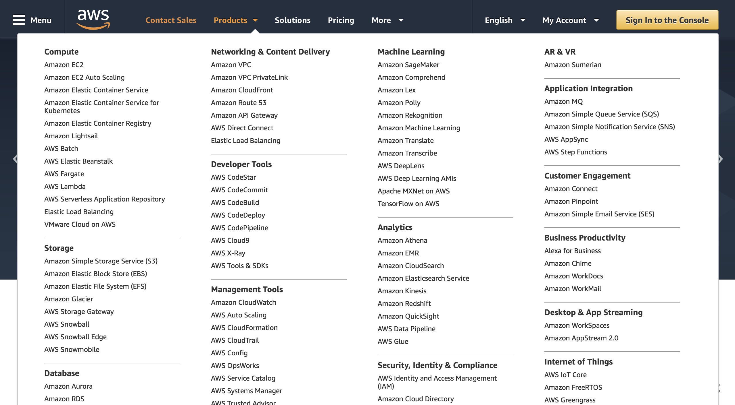
Amazon Web Services (AWS)
Notes:
Creating AWS account: http://www.youtube.com/watch?v=WviHsoz8yHk
Getting started with Amazon EC2-launch a windows instance: http://www.youtube.com/watch?v=OLfmqcYnhUM

Slide 3

What is EC2?
Amazon EC2
“Amazon Elastic Compute Cloud (Amazon EC2) is a web service that enables you to launch and manage Linux/Unix and windows server instances in Amazon's data centers.”
EC2 is part of Amazon’s “pay per use” web services for software development

Slide 4
Outline
Create an AWS Account
Launch an EC2 Instance
Connect to an EC2 Instance
Stop an EC2 Instance

Slide 5
I am Going to Introduce 2 Ways
Way 1: Get started with a AWS Academy Account
Prof. Yu has obtained computational resources from AWS
Every student gets $50 USD credits
Activate account via invitation link from the instructor
Way 2: Get started with a normal account
If some services are not supported by AWS Academy
If the $50 USD credits have been run out
...

Slide 6
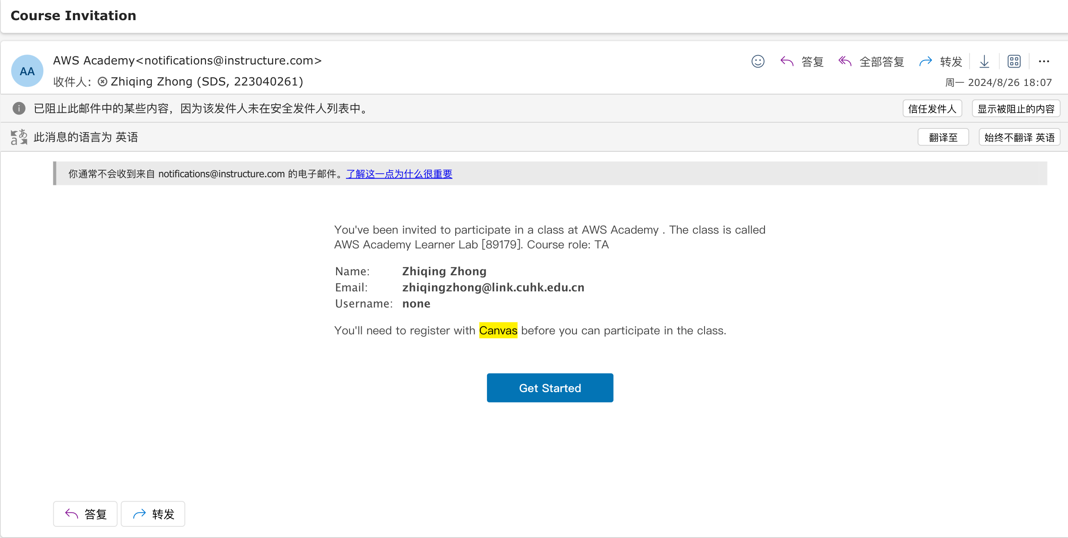
Get Started with an AWS Academy account
After receiving this email, just click on the link

Slide 7
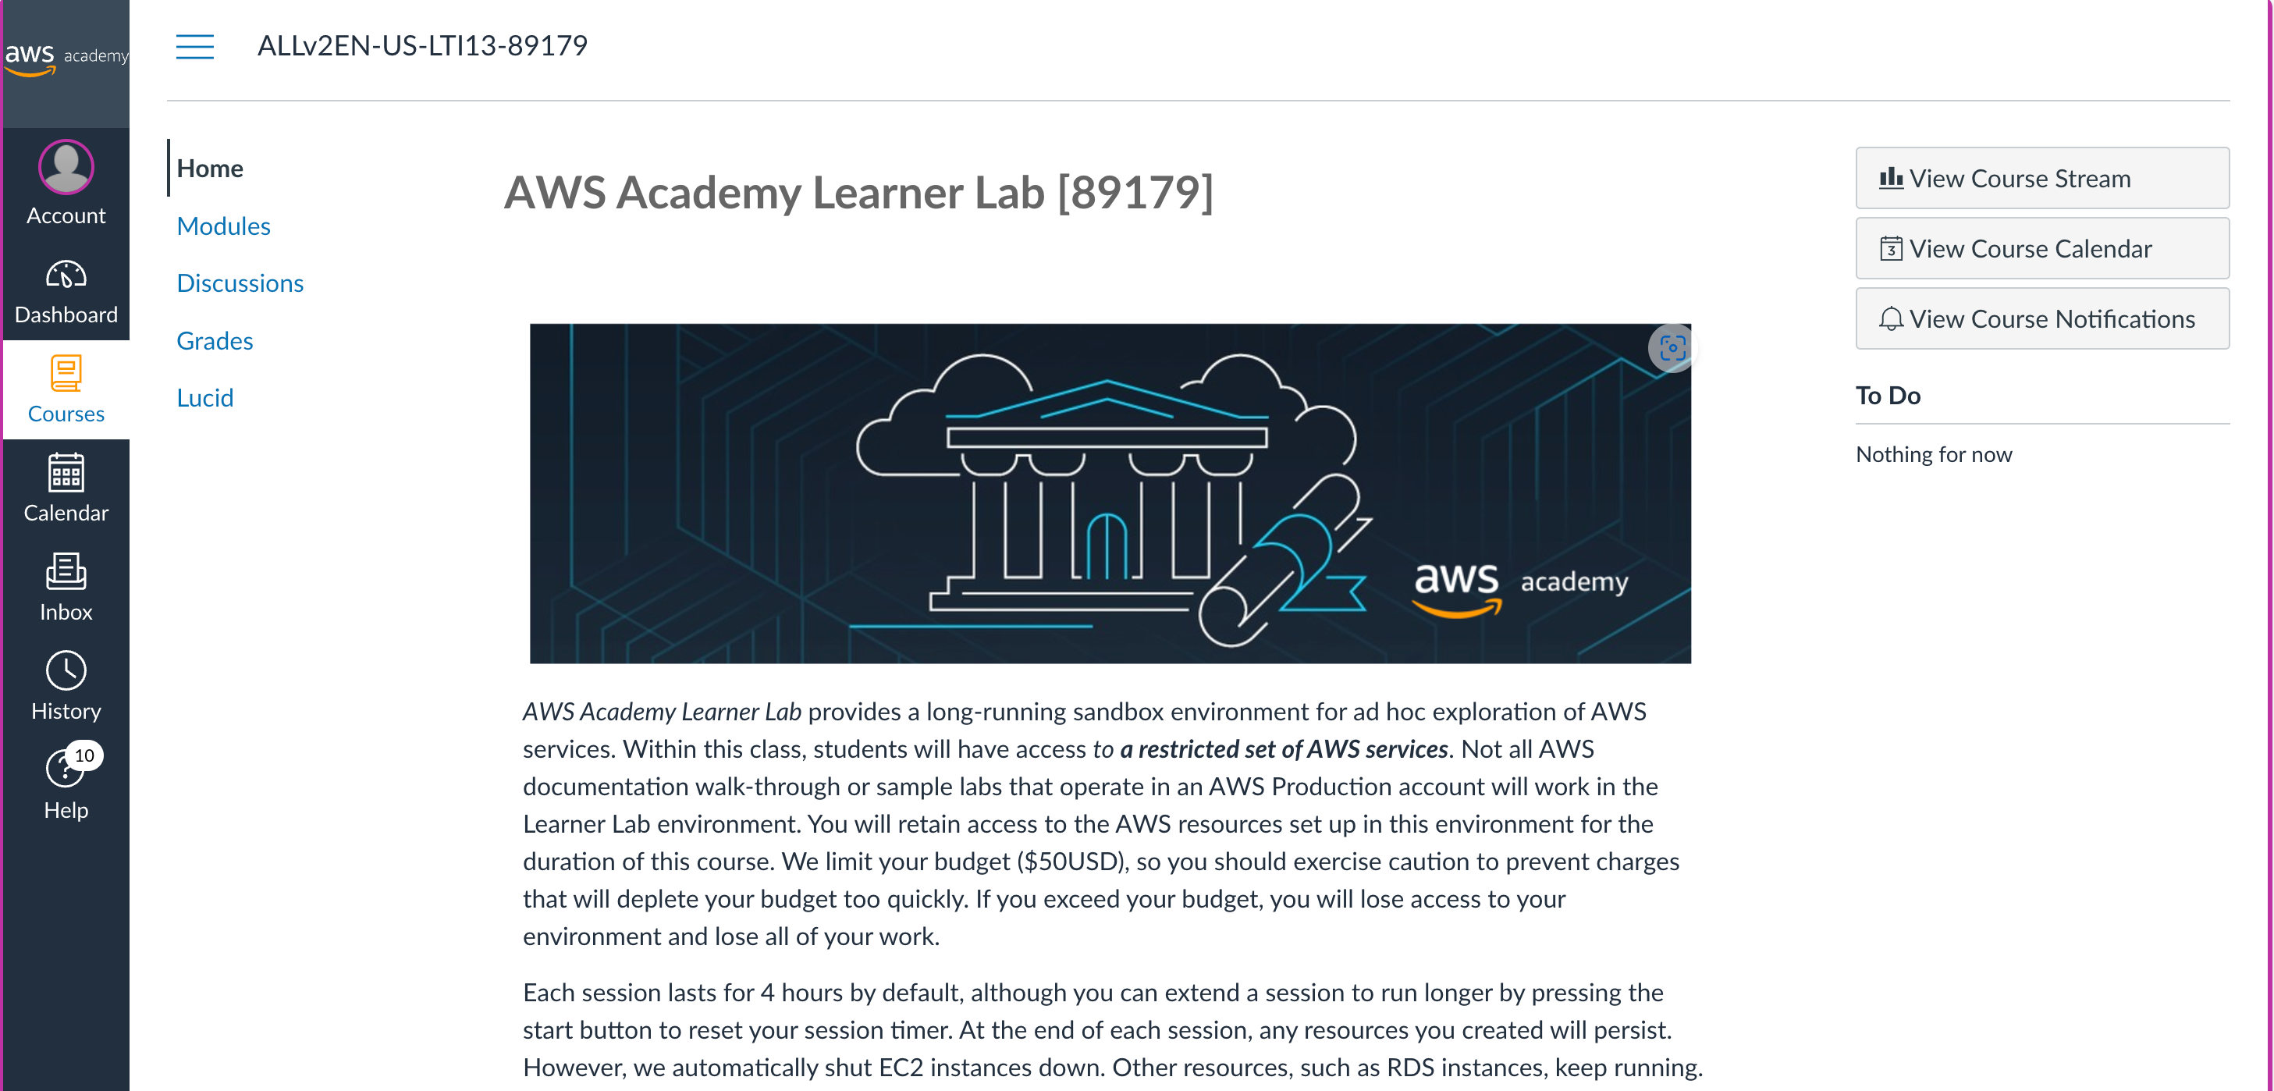
Get Started with an AWS Academy account
Now you enter the AWS academy Portal
Please read the Learner Lab introduction

Slide 8
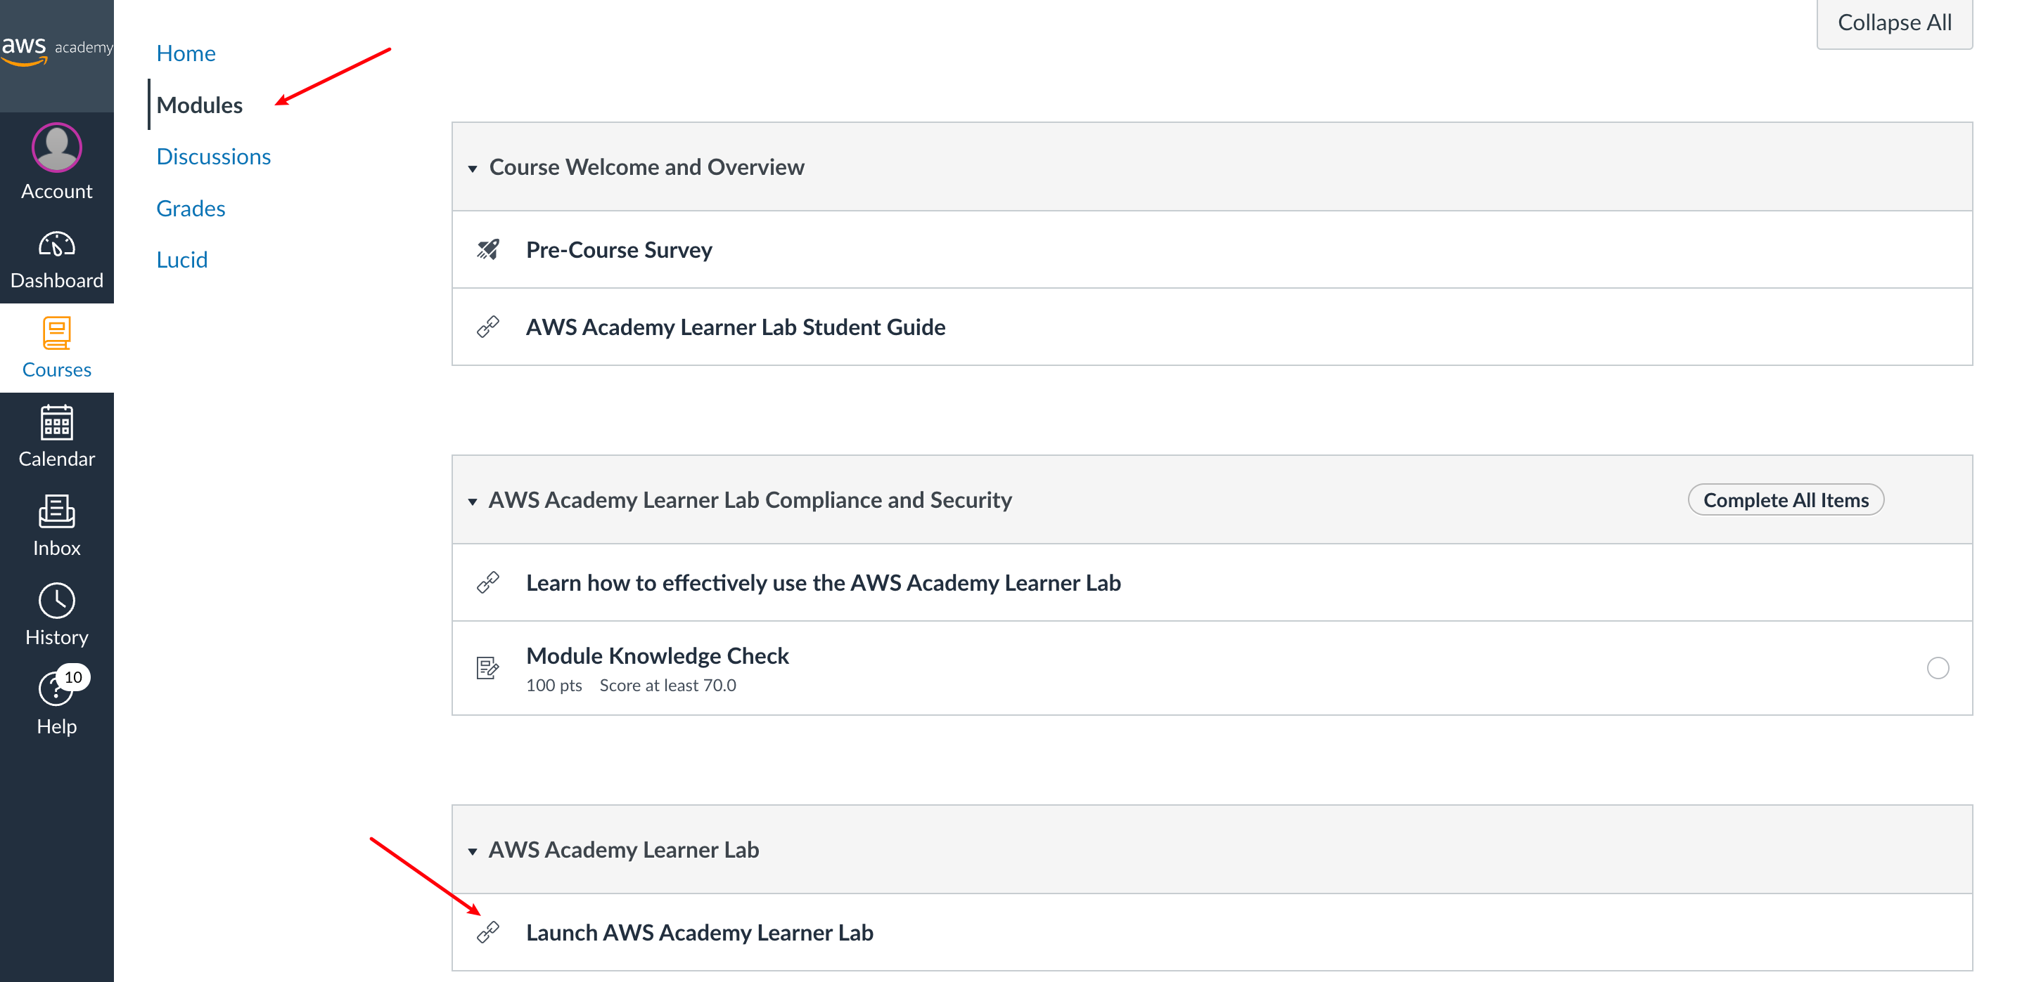
Get Started with an AWS Academy account
1. Click Modules
2. Launch AWS Academy Learner Lab

Slide 9
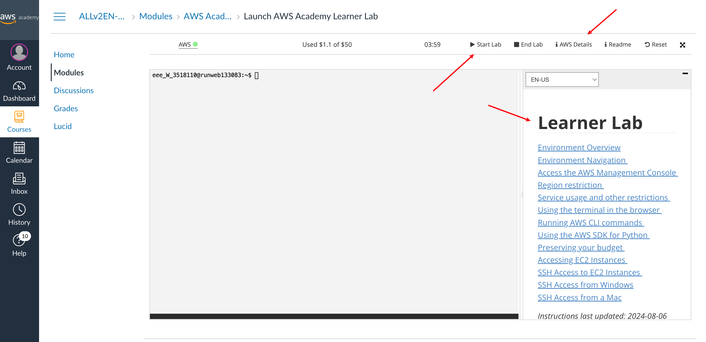
Get Started with an AWS Academy account
3. Check AWS Details
2. Press Start Lab
1. Read Learner Lab docs

Slide 10
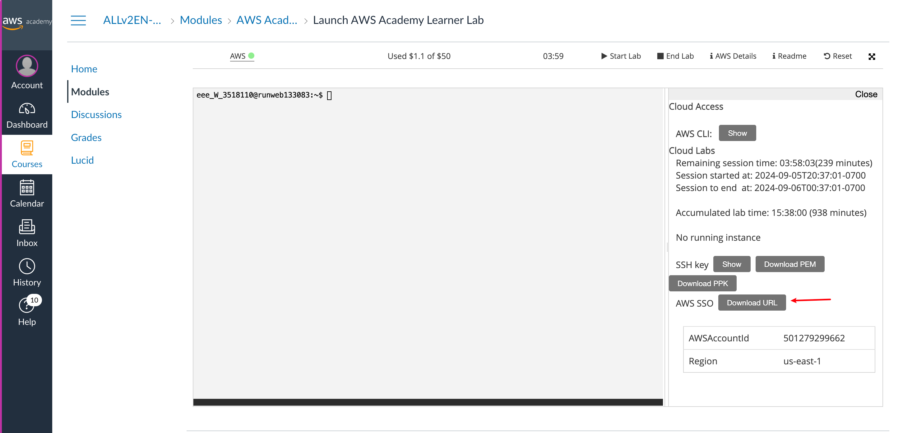
Get Started with an AWS Academy account
Obtain URL to AWS Portal

Slide 11
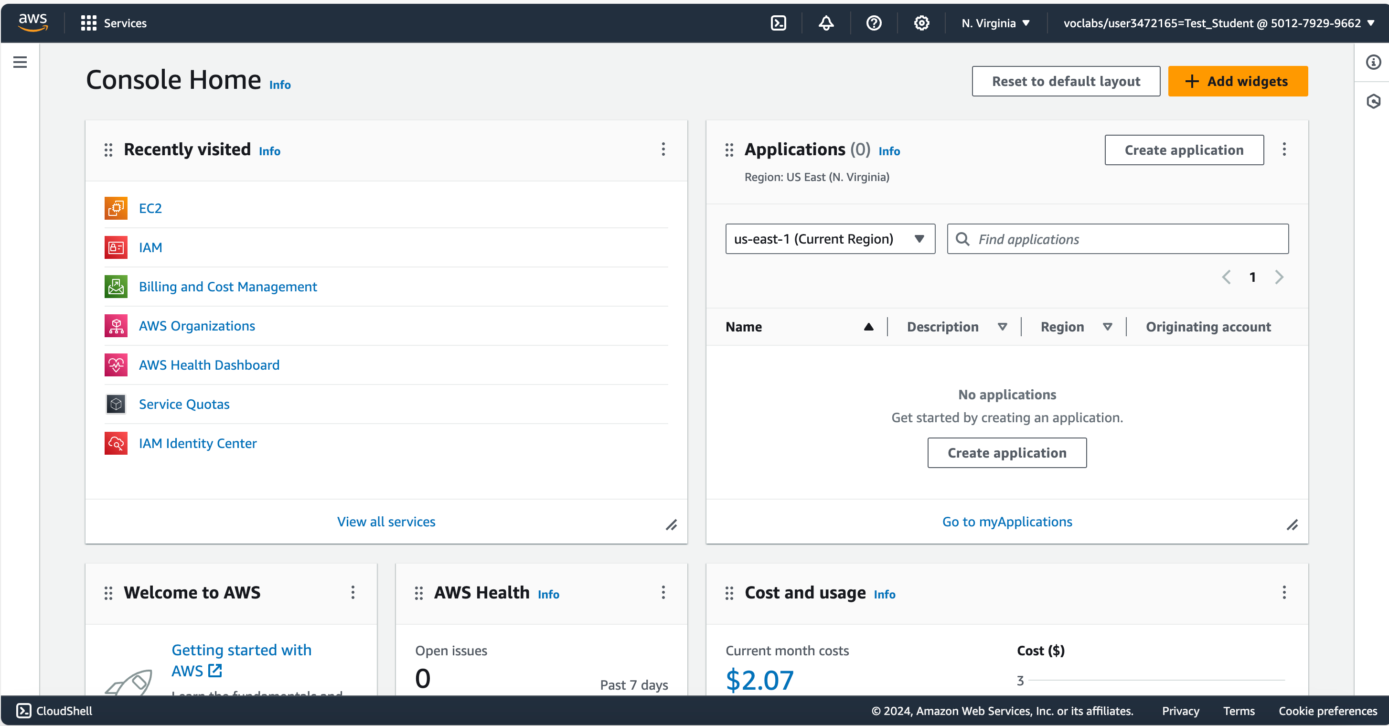
Get Started with an AWS Academy account
Feel free to explore the AWS Management Console

Slide 12
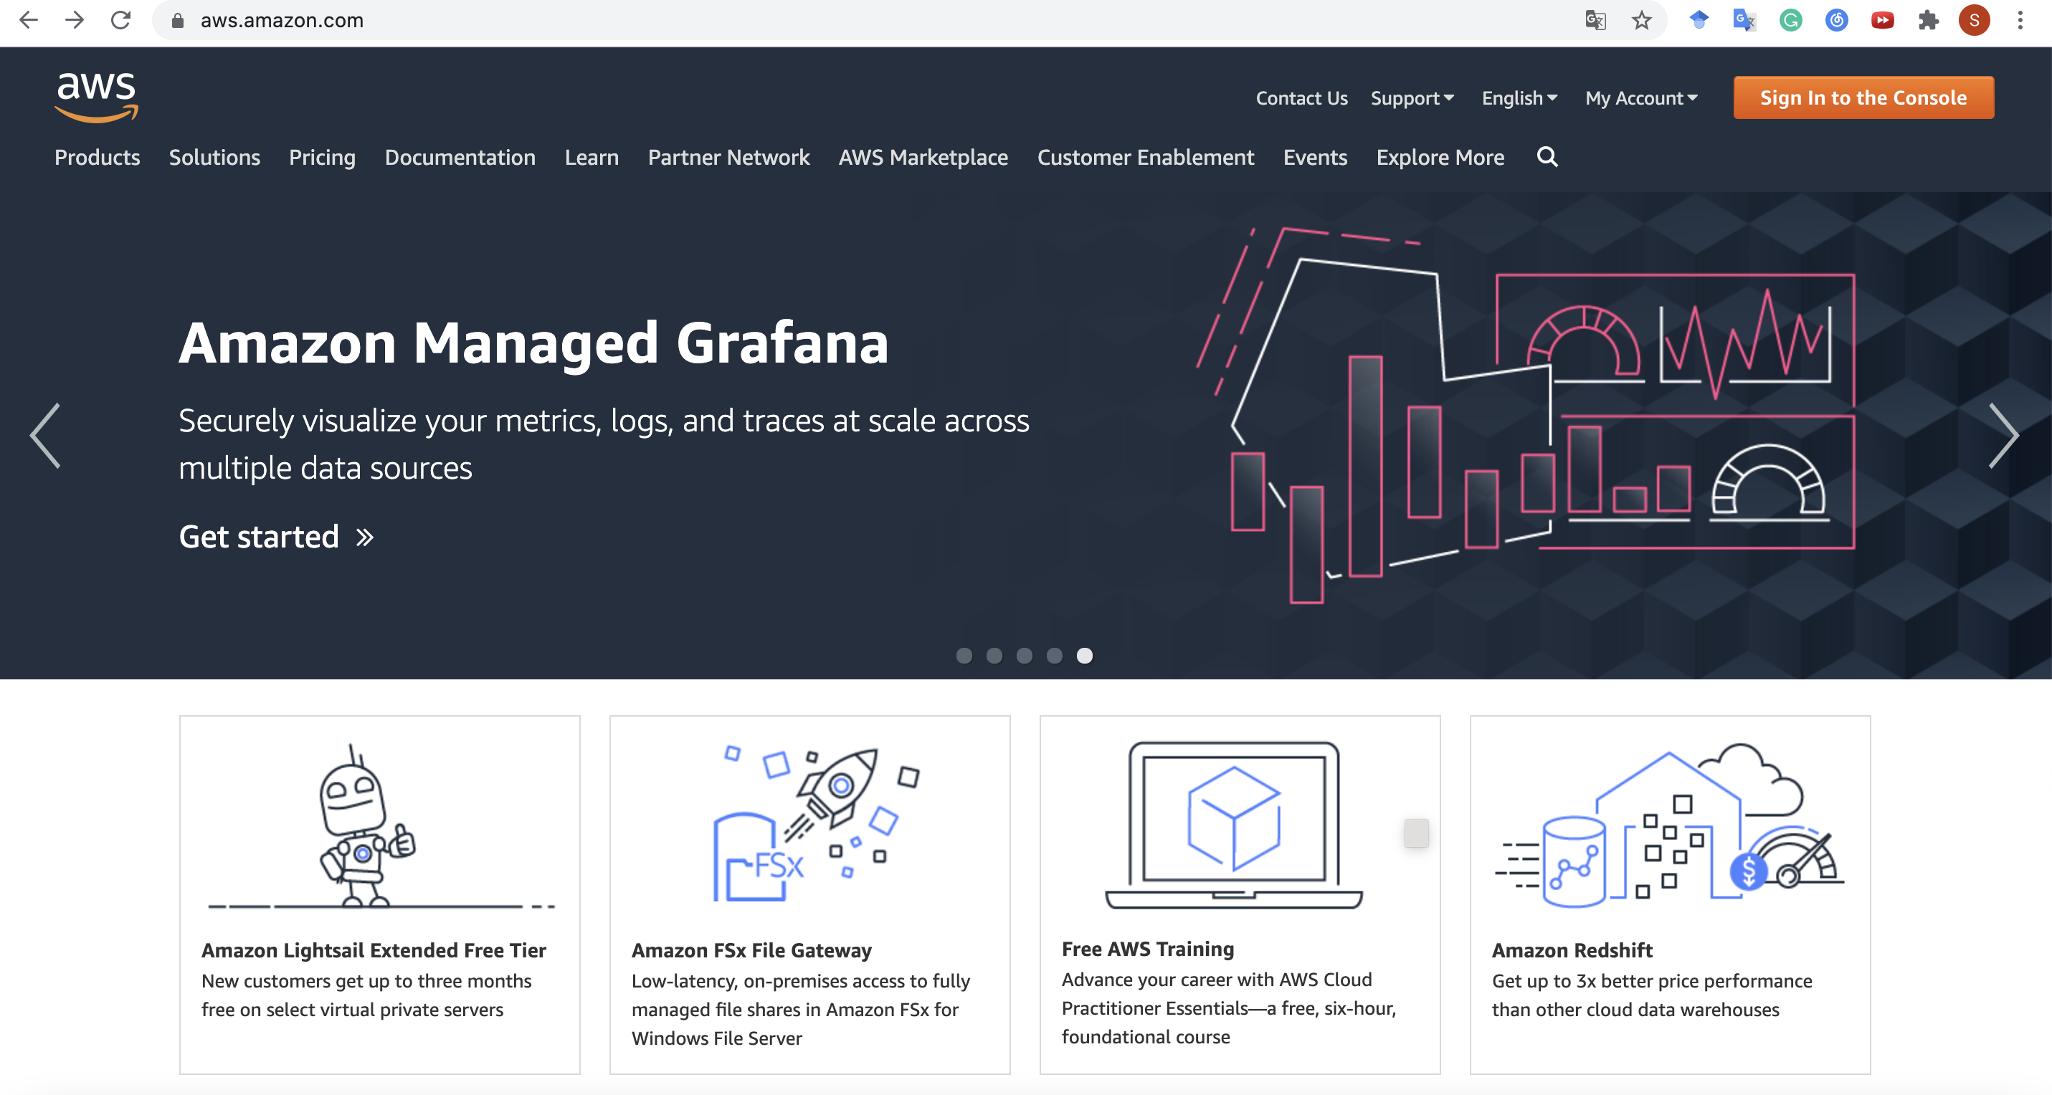
Get Started with a Normal AWS Account
Click here

Slide 13
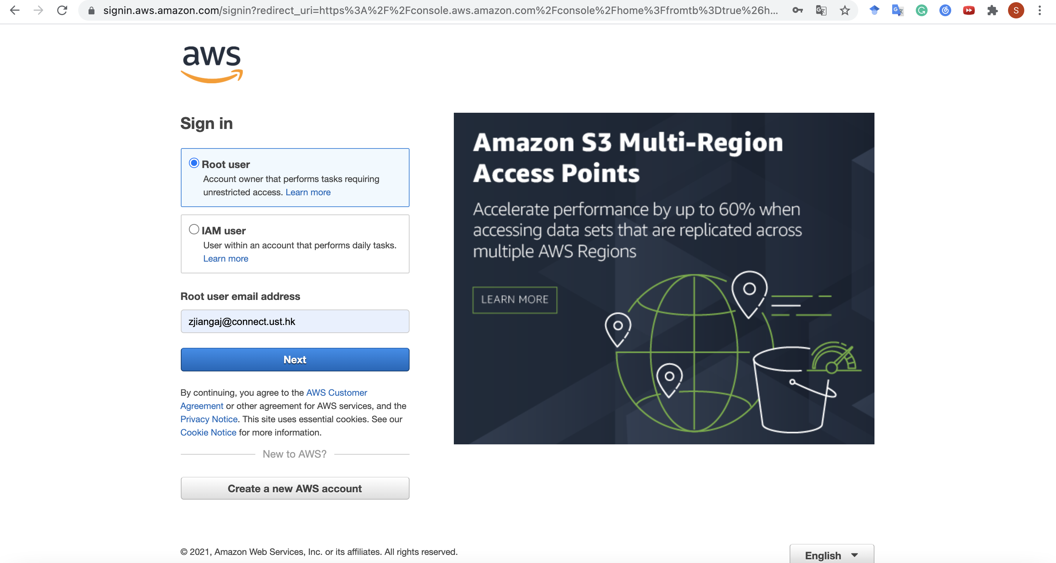
Get Started with a Normal AWS Account
Then here

Slide 14
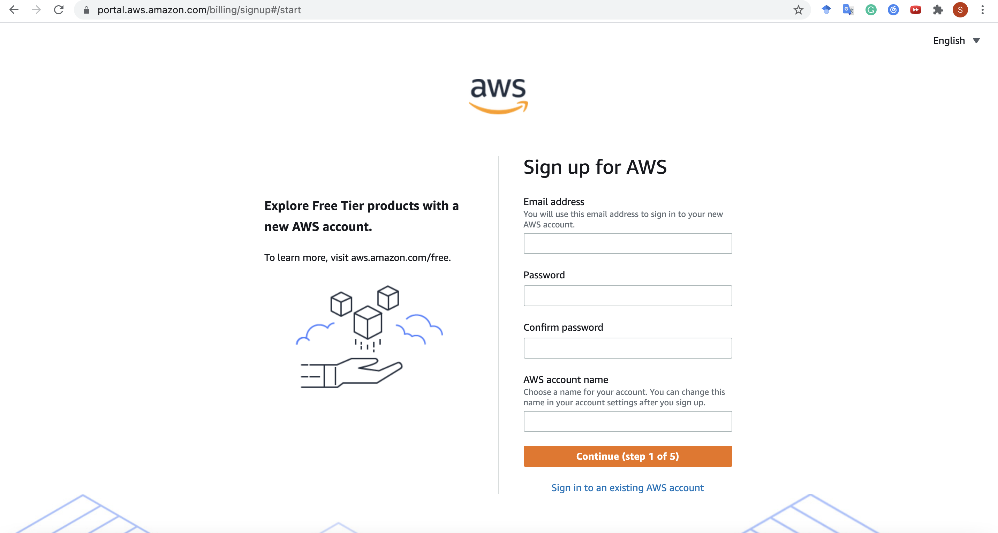
Get Started with a Normal AWS Account
Enter your credentials

Slide 15
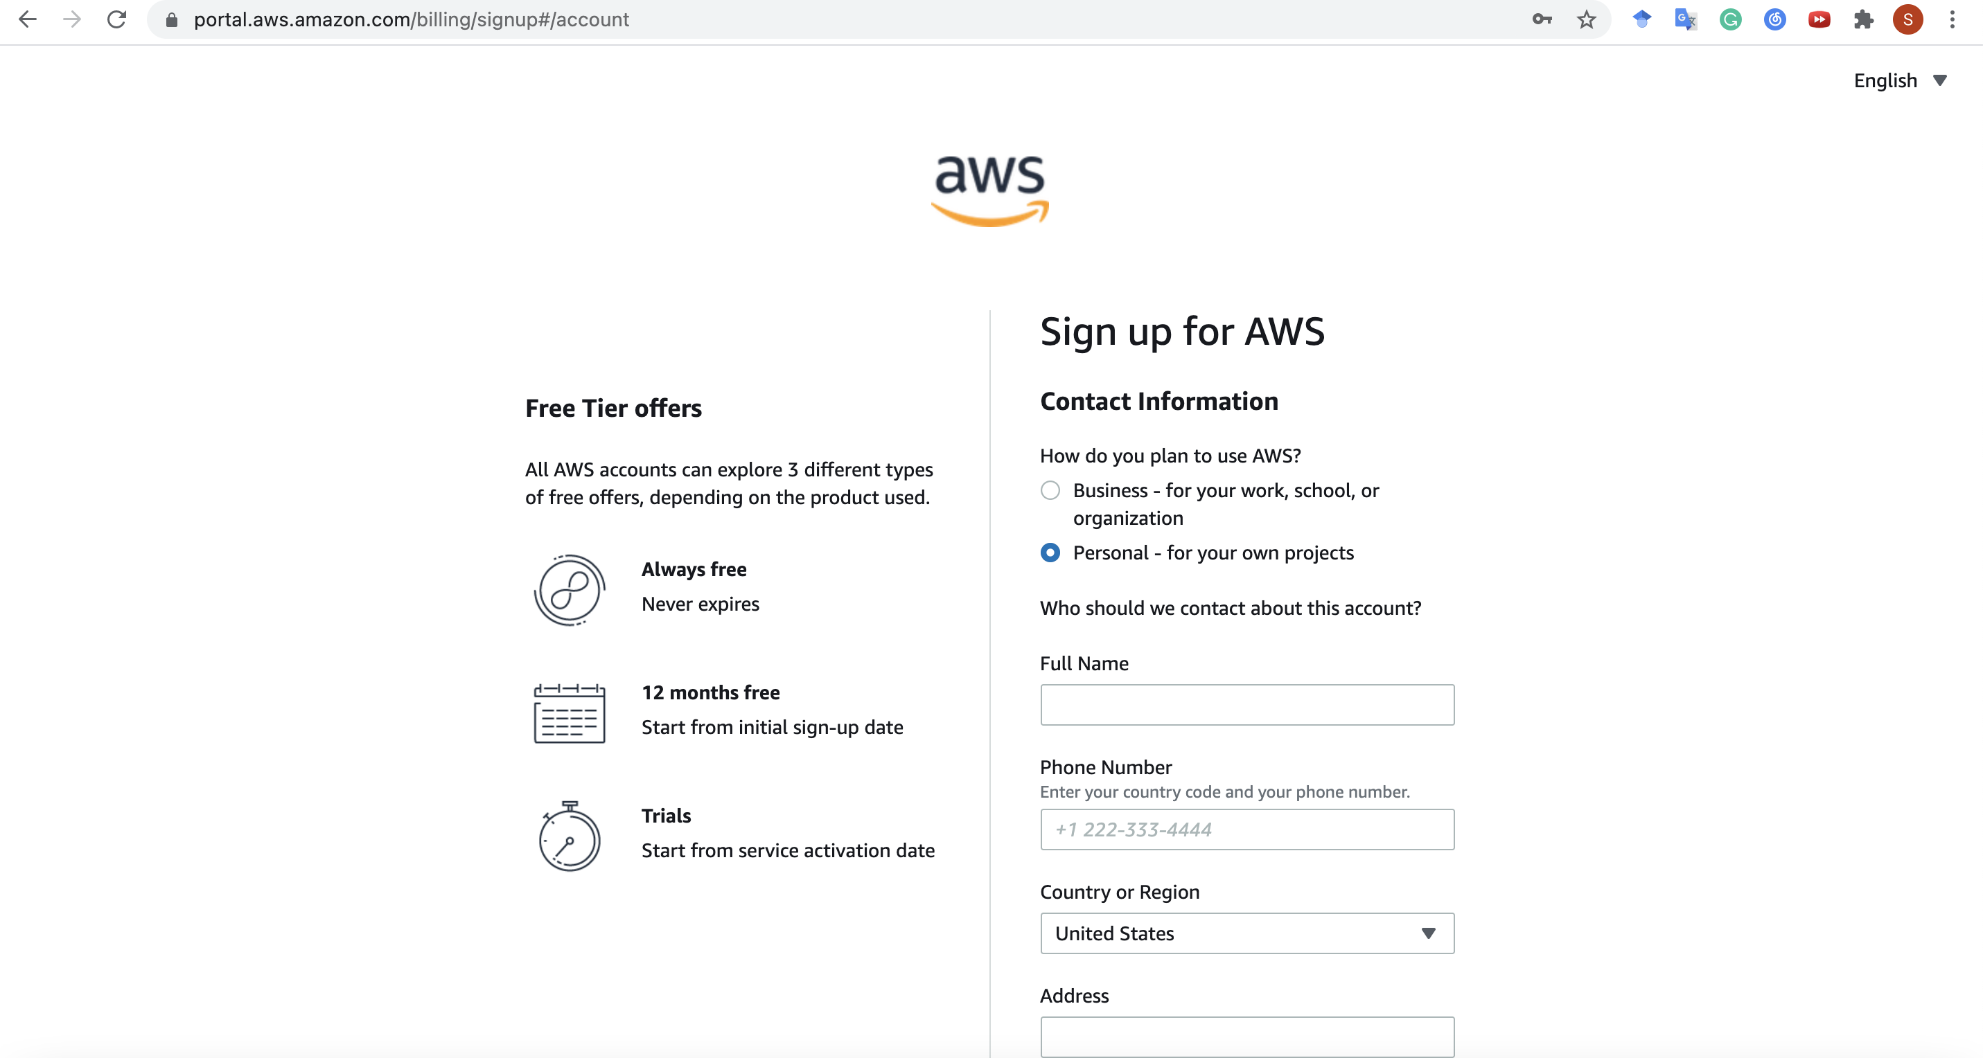
Get Started with a Normal AWS Account
Choose “Personal” and
enter your information…

Slide 16
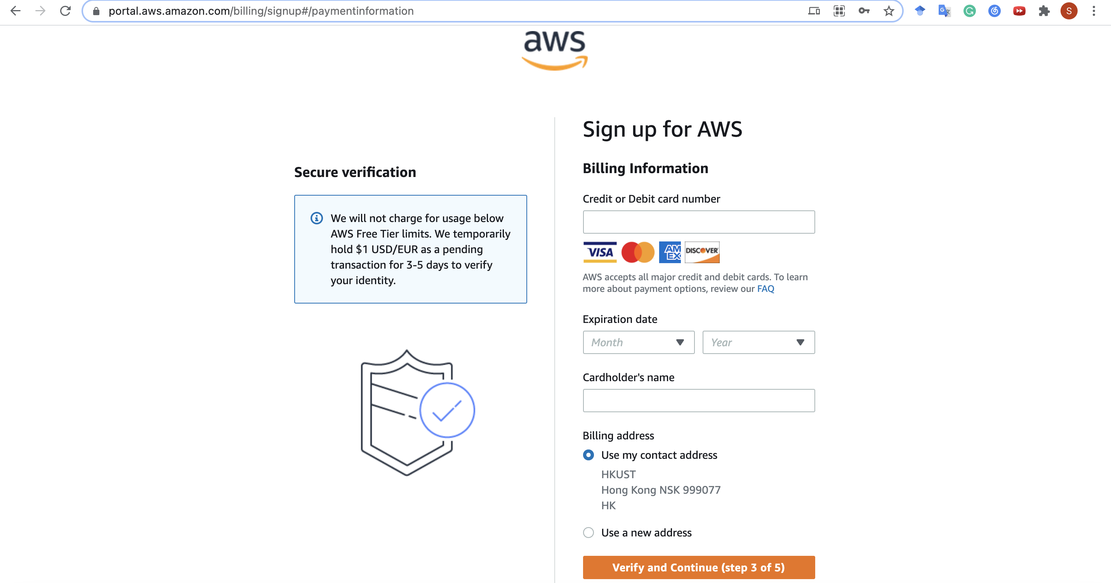
Get Started with a Normal AWS Account
and card information…

Slide 17
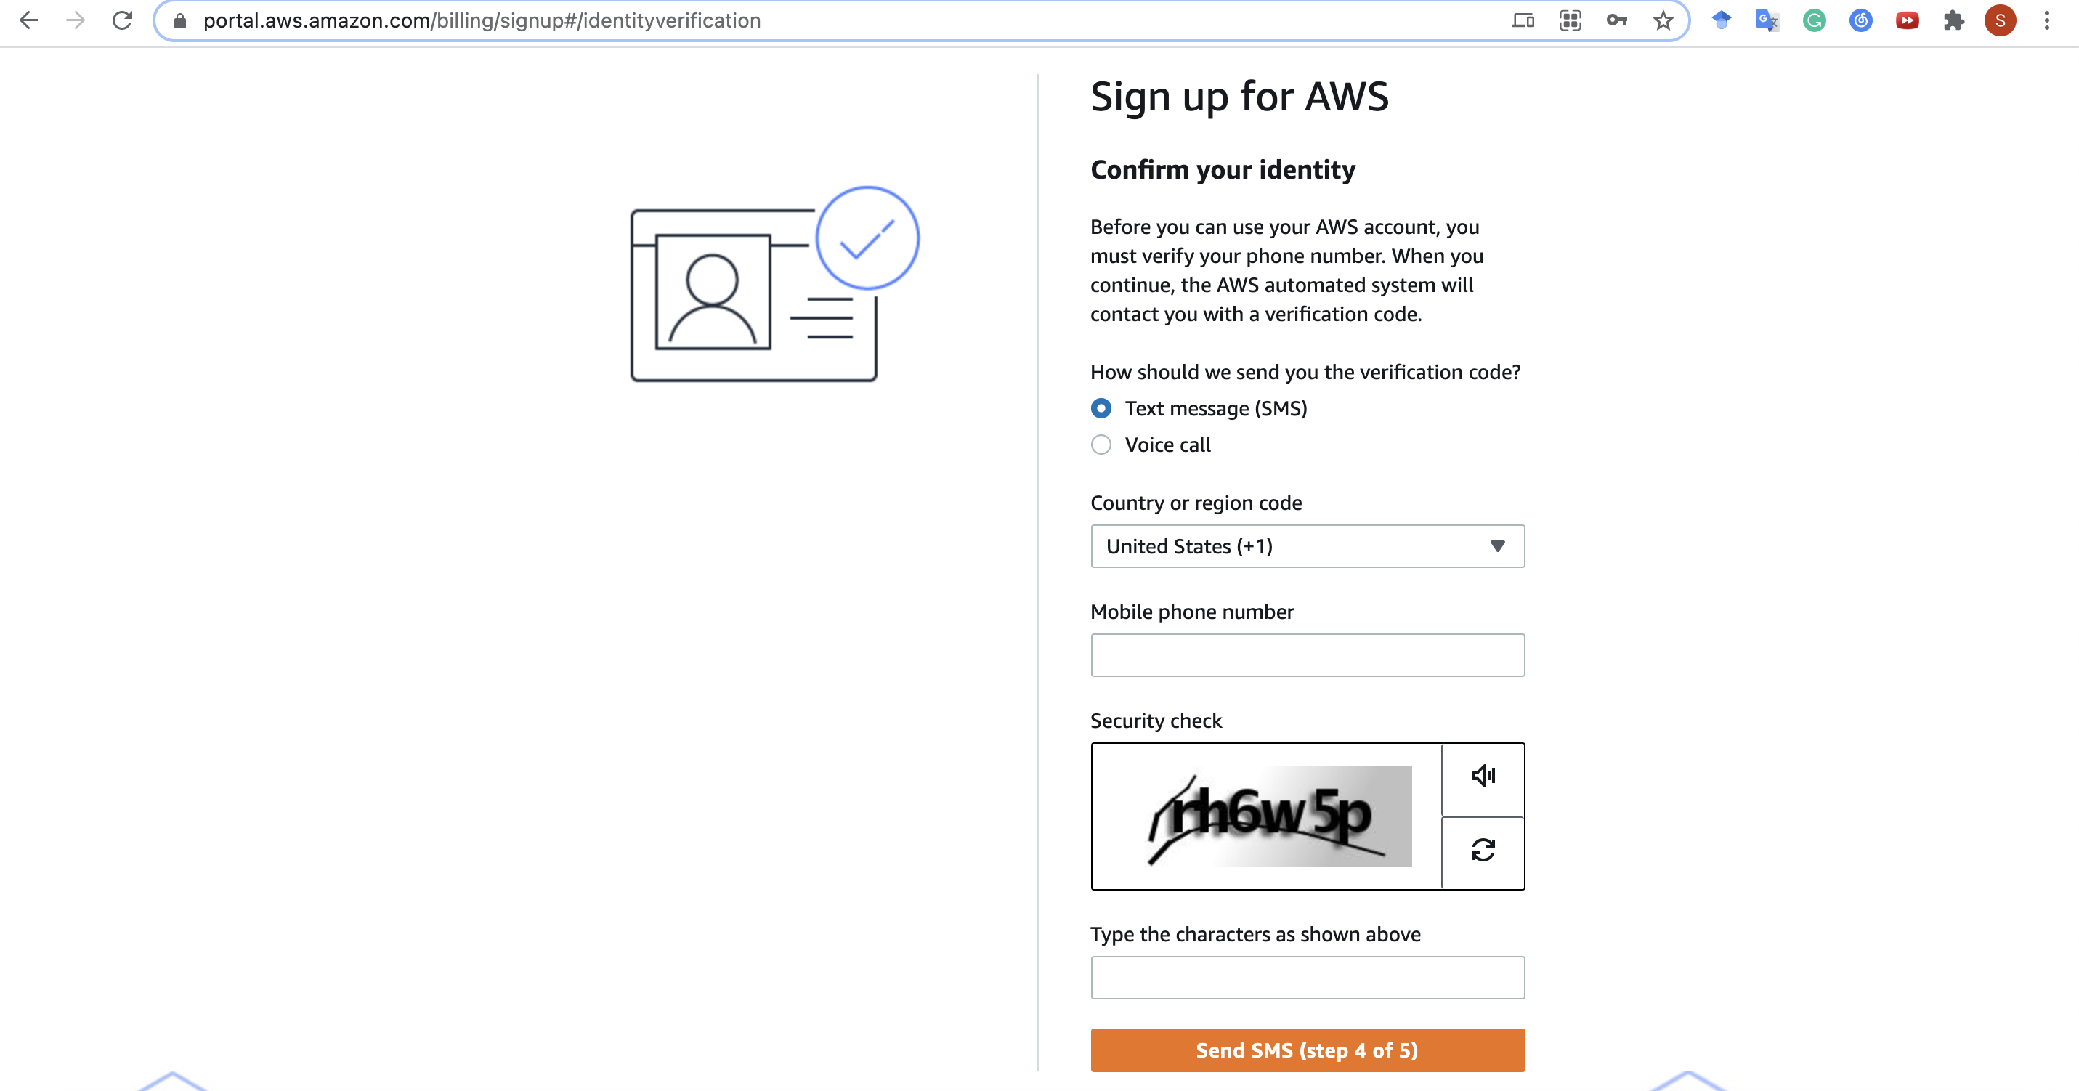
Get Started with a Normal AWS Account
and phone number

Slide 18
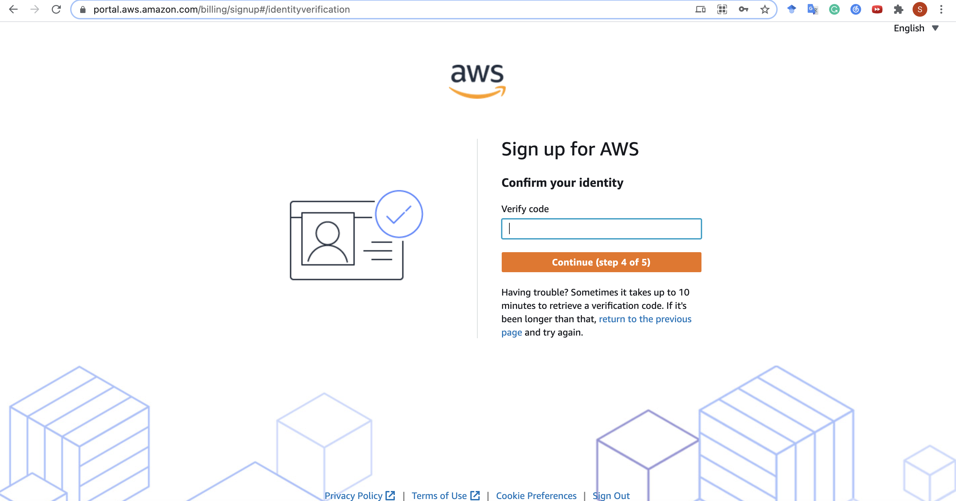
Get Started with a Normal AWS Account
Enter the verify code you receive via SMS
p.s. Authentication via Voice call is also OK

Slide 19
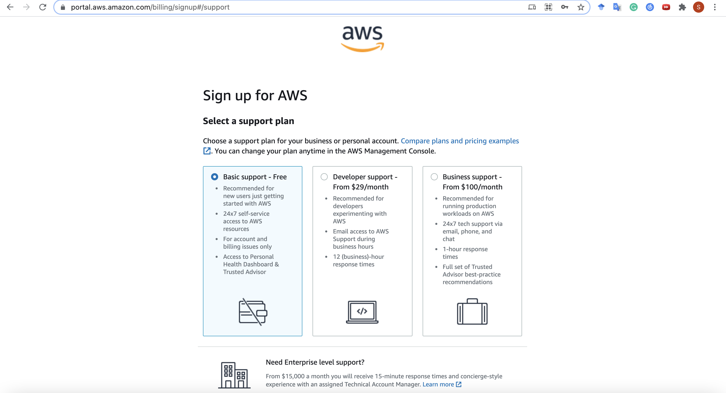
Get Started with a Normal AWS Account
Select “Basic Plan”
and complete!

Slide 20
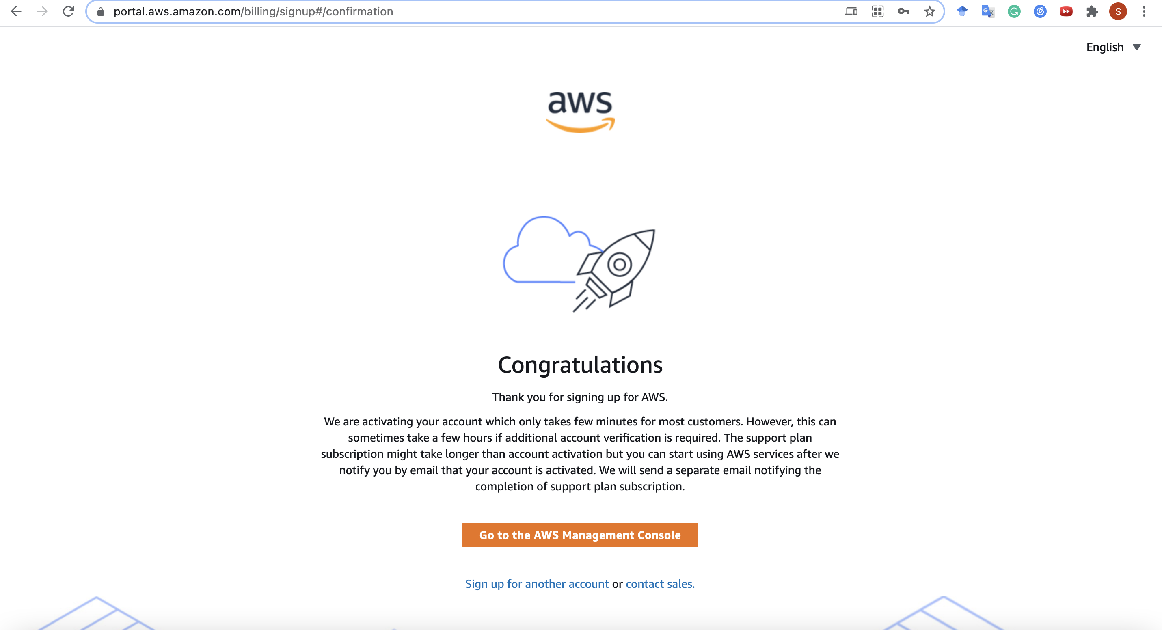
Get Started with a Normal AWS Account
Cool! Try to sign in here

Slide 21
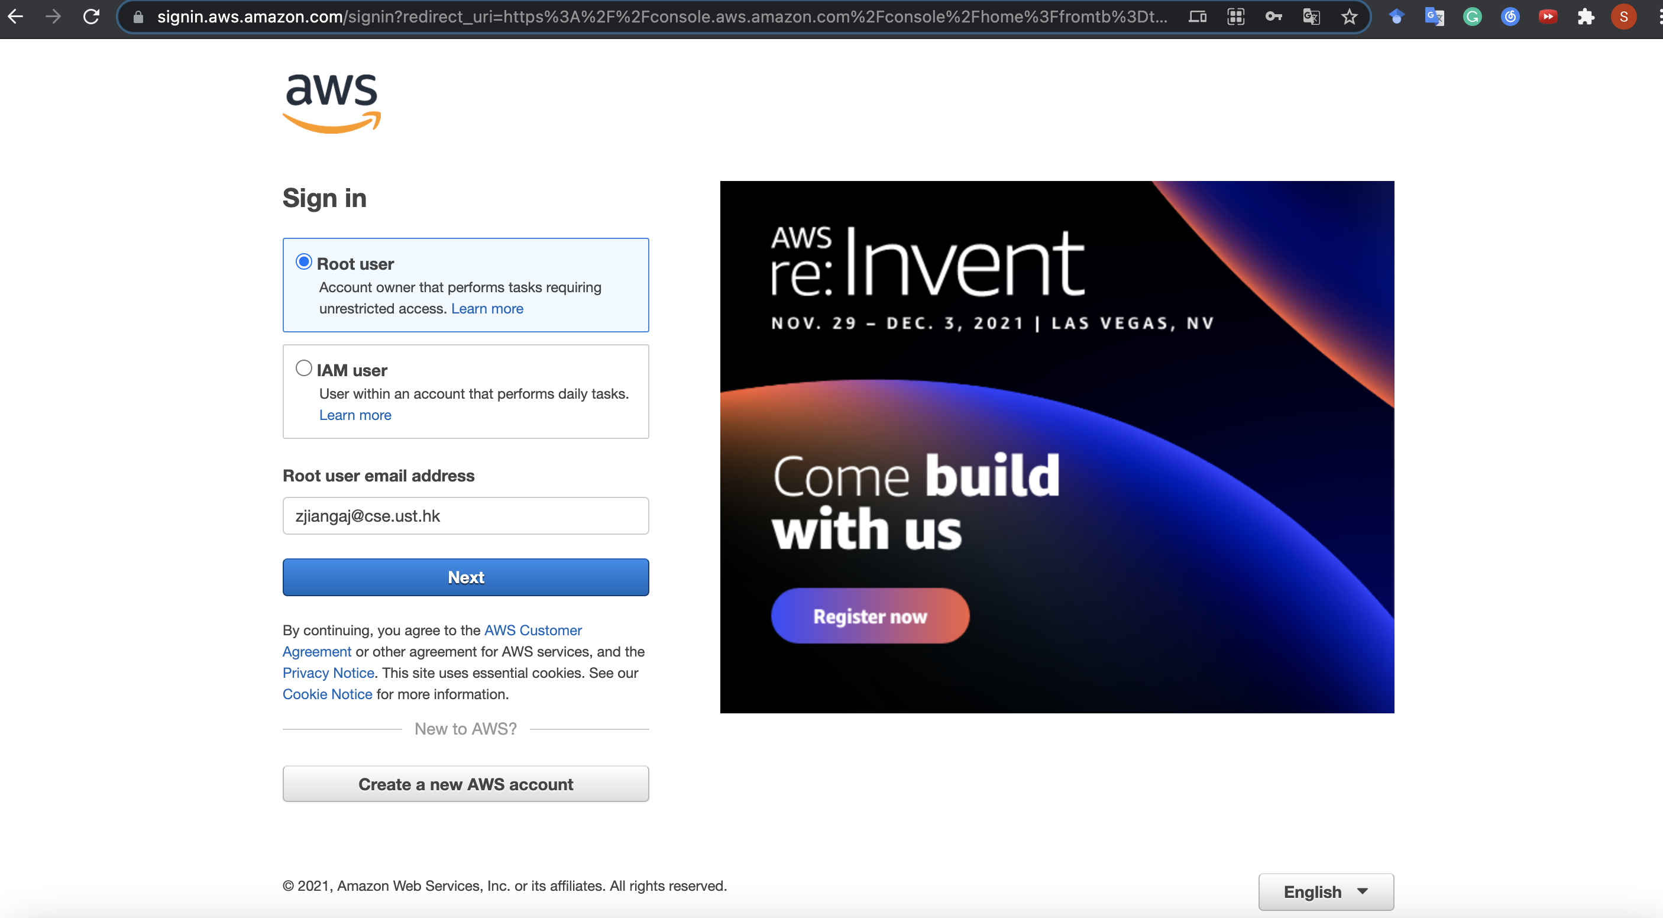
Get Started with a Normal AWS Account
Select root user

Slide 22
Get Started with a Normal AWS Account
Finish! You may explore the console now...

Slide 23
Outline
Create an AWS Account
Launch an EC2 Instance
Connect to EC2 Instance
Stop an Instance

Slide 24
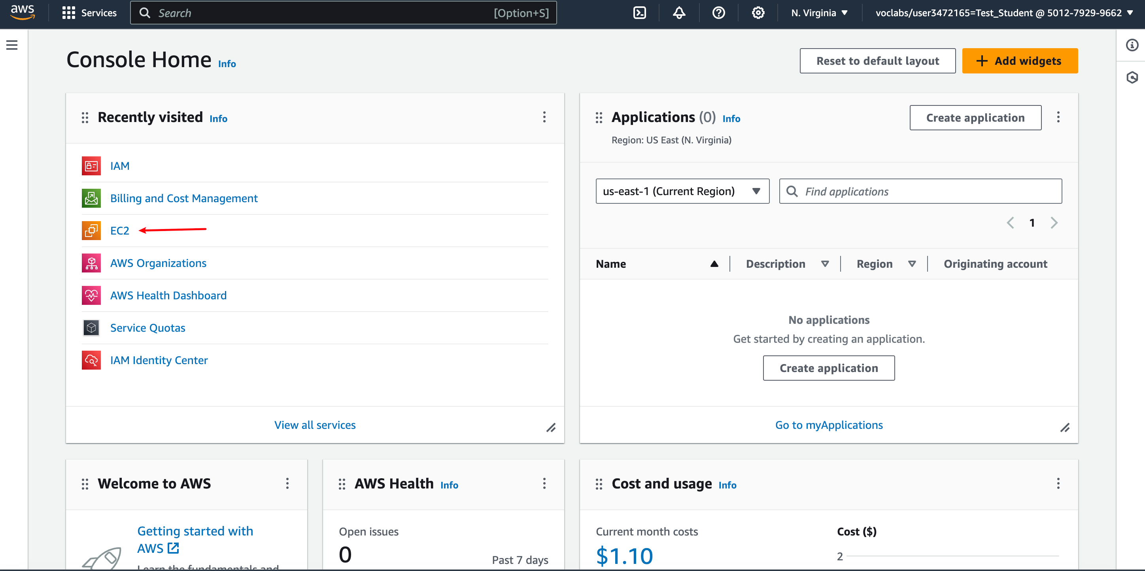
Surf the EC2 Console
Click here to enter
EC2 management console

Slide 25
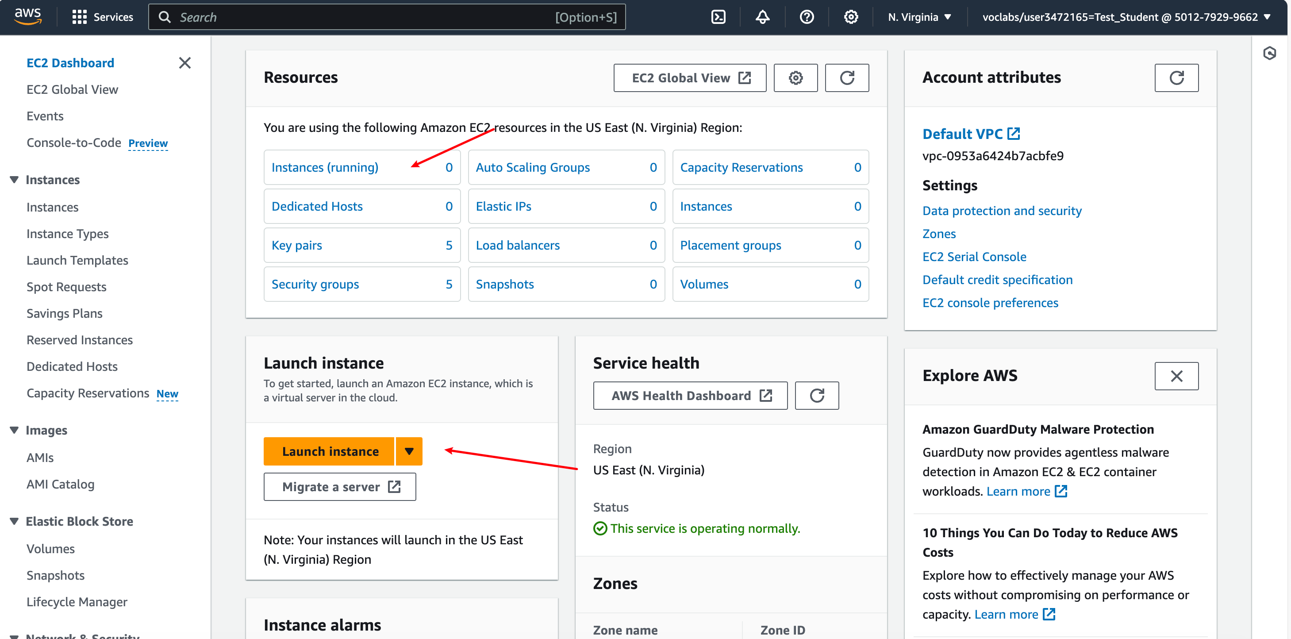
Surf the EC2 Console
You will see the Instances panel

Slide 26
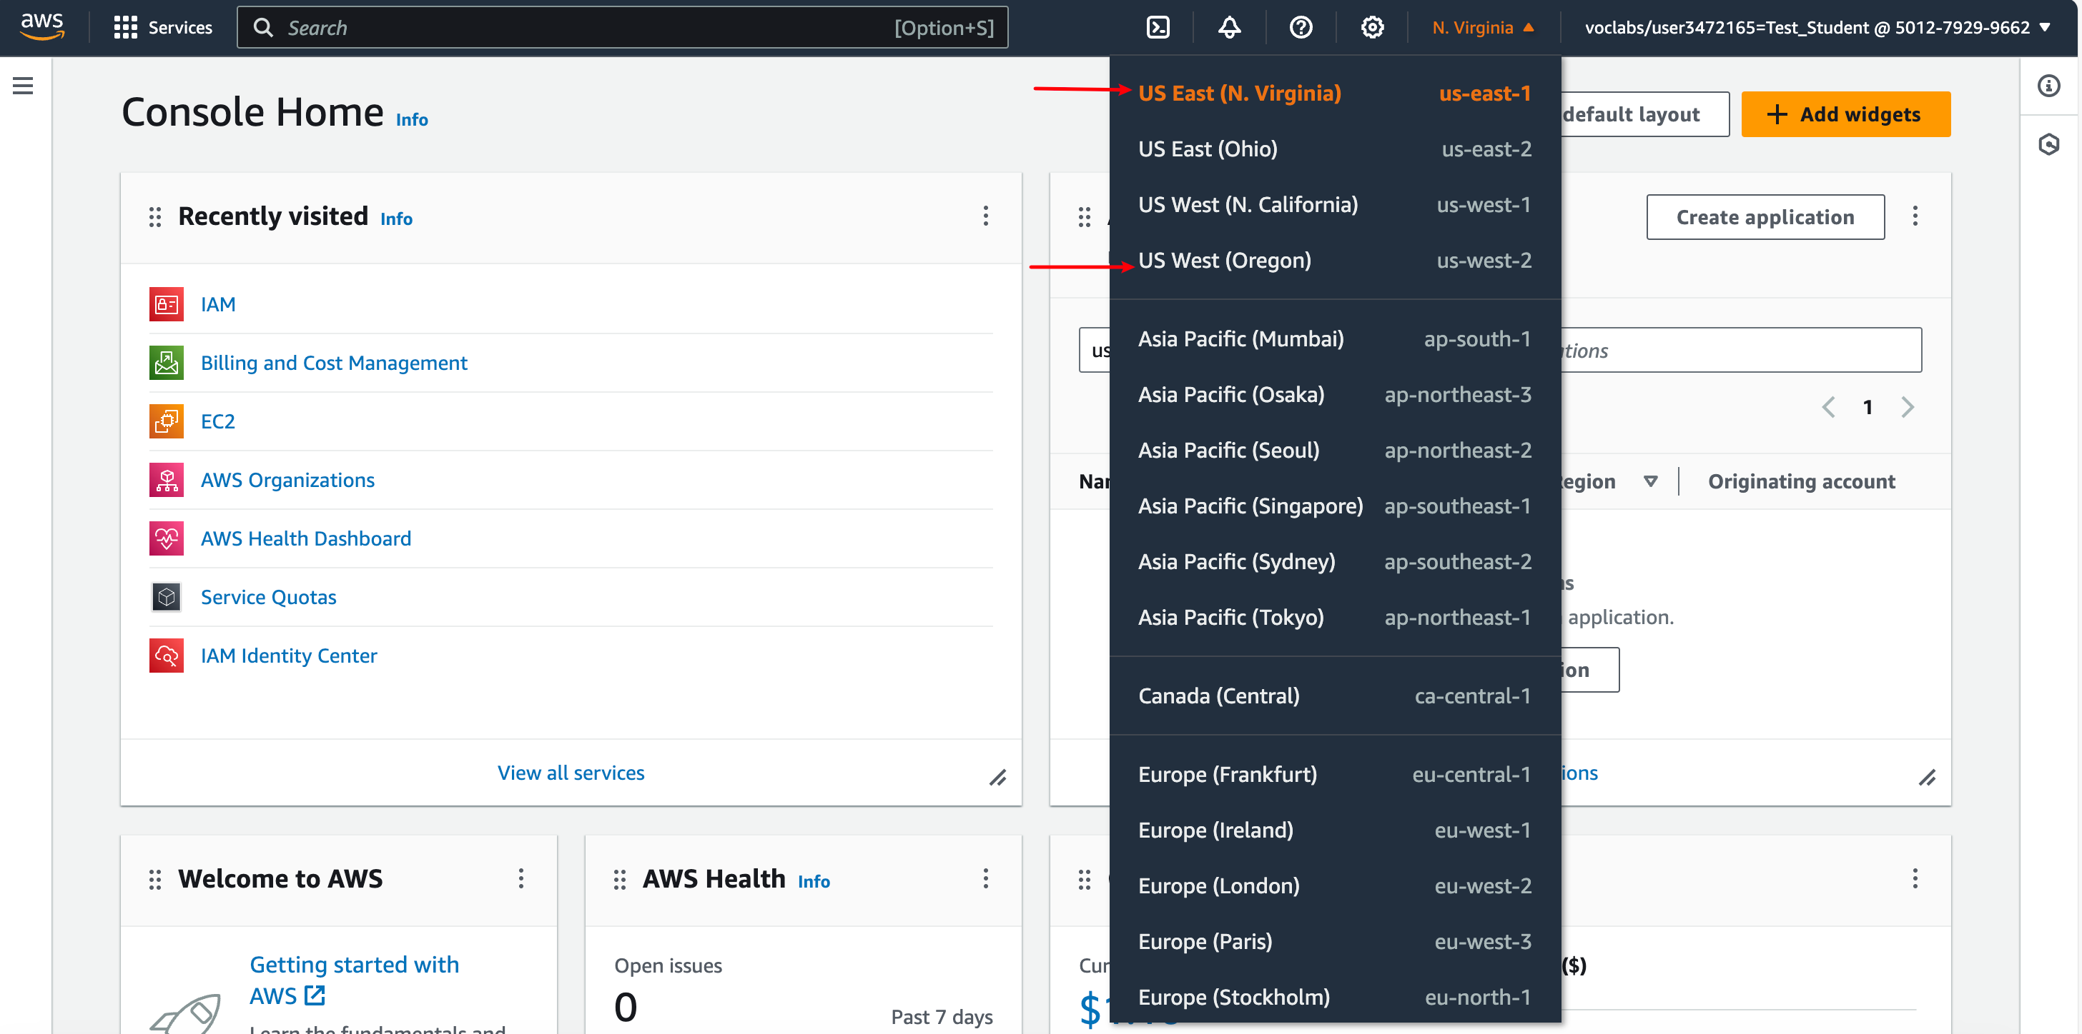
Switch to another EC2 Region
AWS provides EC2 instance located from different regions across the world
You can switch to a region that best suits you
(e.g., using us-east-1 if you are using a student account)

Slide 27
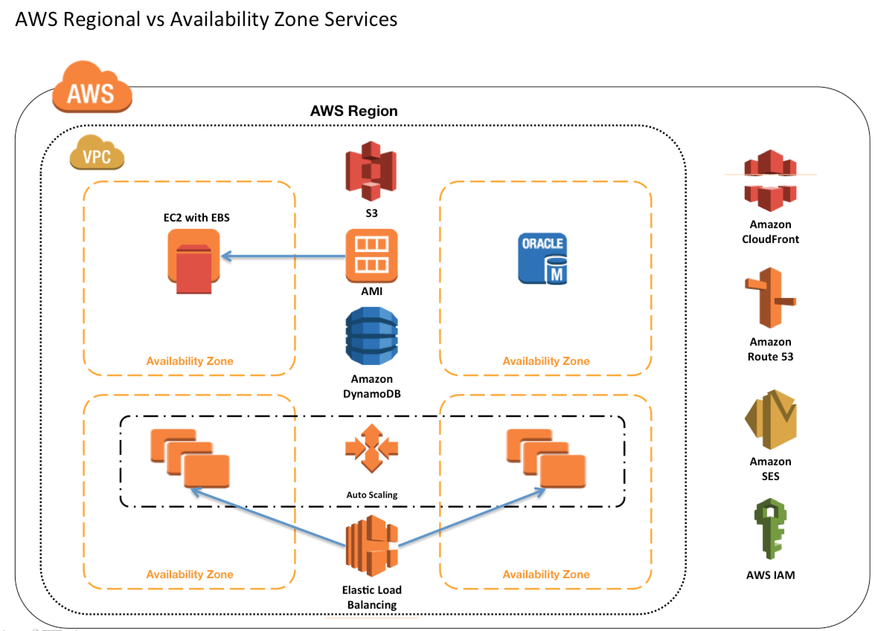
Pro Tip: Try to launch all your instances in the same availability zone, or inter-zone communication will cost you $$$$.

Slide 28
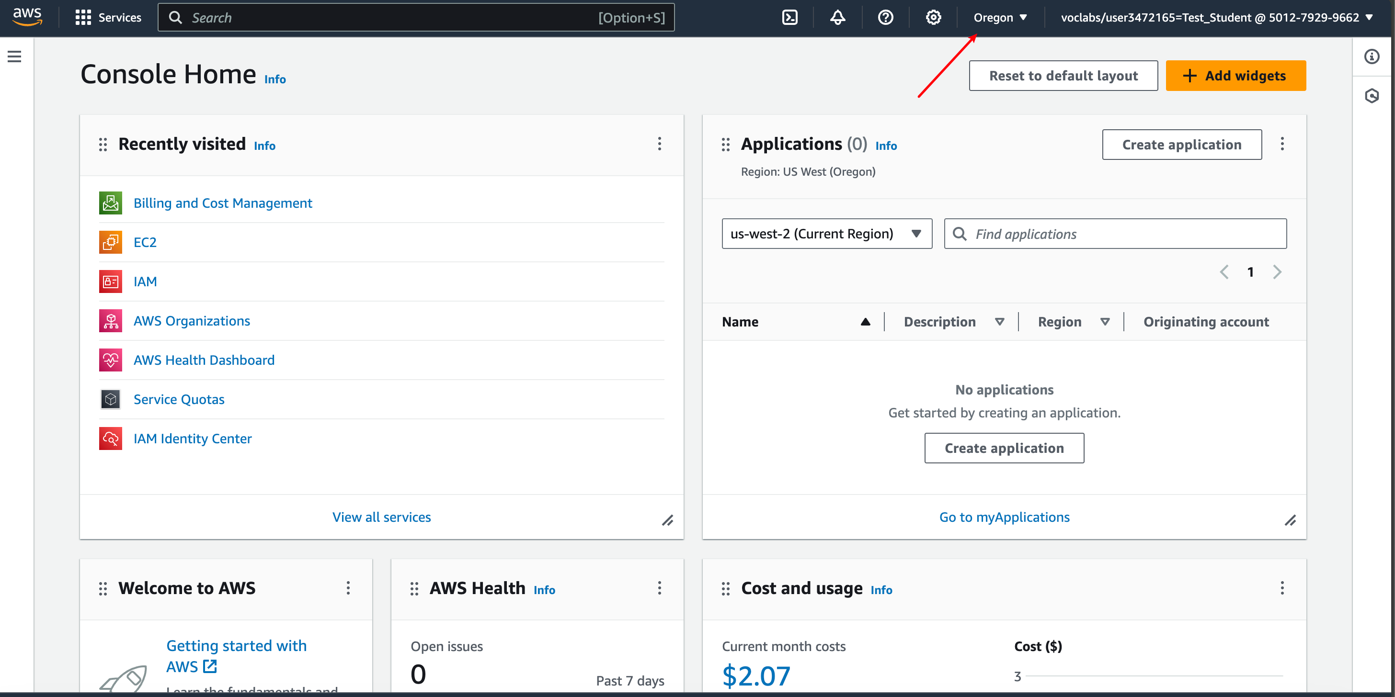
Switch to another EC2 Region
On success

Slide 29






SSH Authentication Process
Private Key
Public Key
User
Server
ssh -i <private_key> user@server
Matching
Session Key
Encrypted Communication

Slide 30
Key pairs
Amazon EC2 uses public–key cryptography to encrypt and decrypt login information.
A public key is used to encrypt data, such as a password, then the recipient uses the private key to decrypt the data.
The public and private keys are known as a key pair.
Notes:
SSH requires key pair.
A brief introduction of public-key cryptography.

Slide 31
Launch an EC2 instance
We are ready to launch instances.

Slide 32
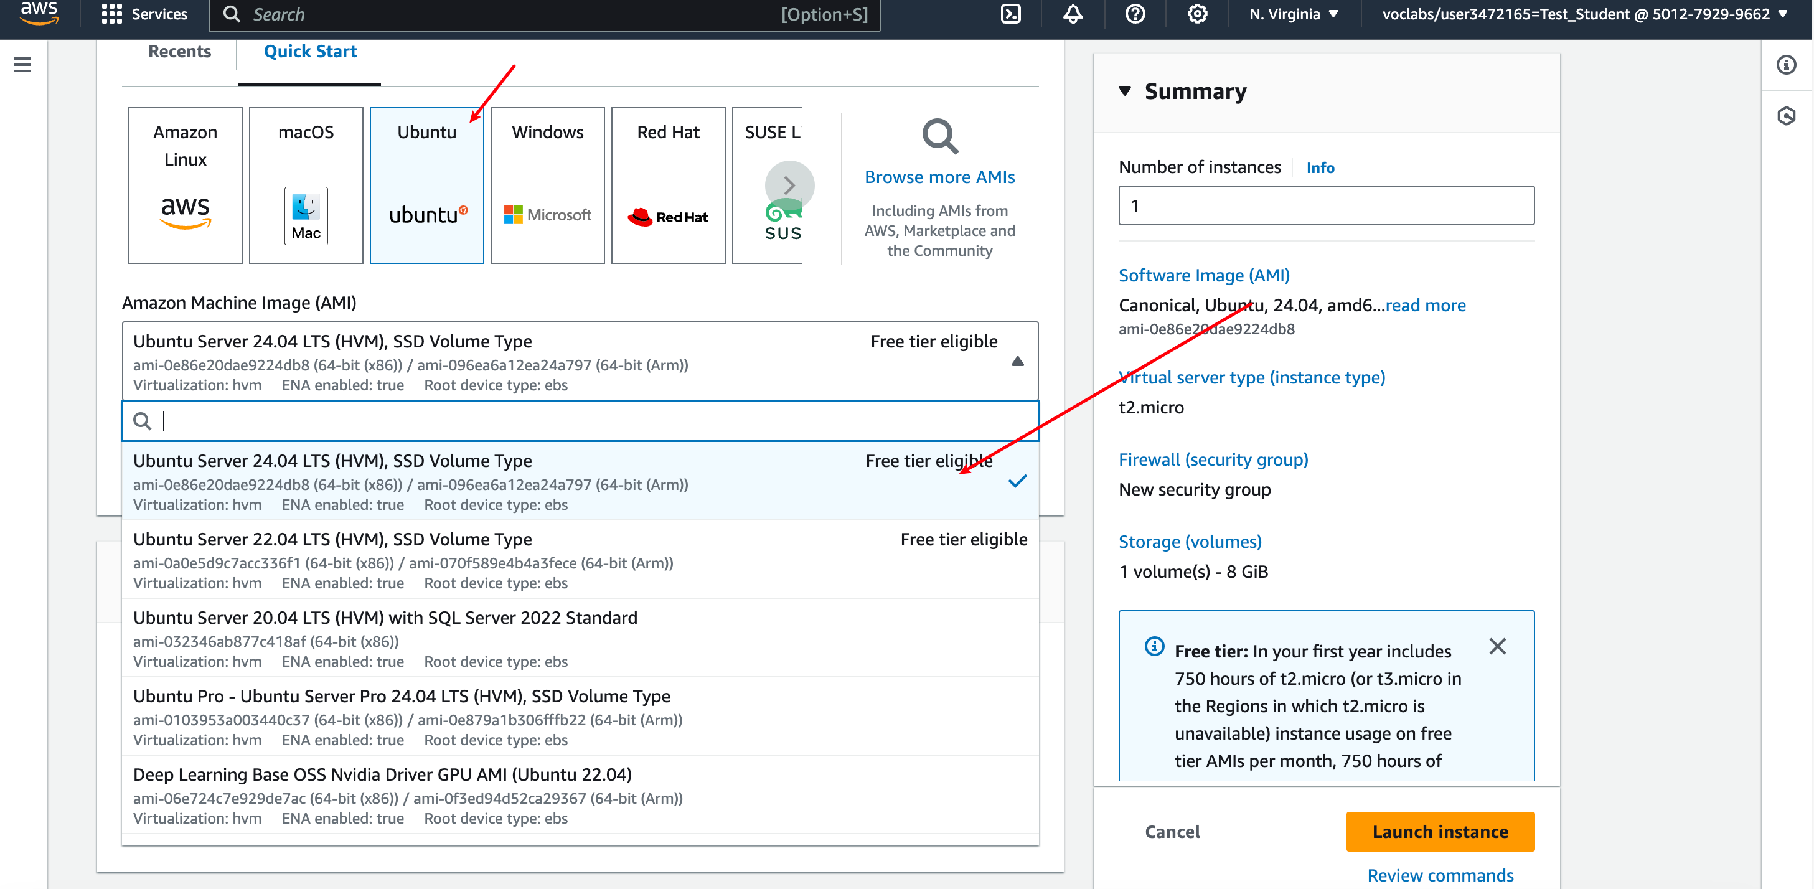
Launch an EC2 instance
Ubuntu is recommended (20.04, 22.04, 24.04)
For example, choose Ubuntu 24.04 and click Select

Slide 33
Server OS in EC2
Common server OS’es: Linux (RedHat, openSUSE, Debian, CentOS, Ubuntu, Amazon Linux) and Windows Server.
There are over 5000 OS images in EC2 to choose from. (2996 versions of ubuntu!)

Slide 34
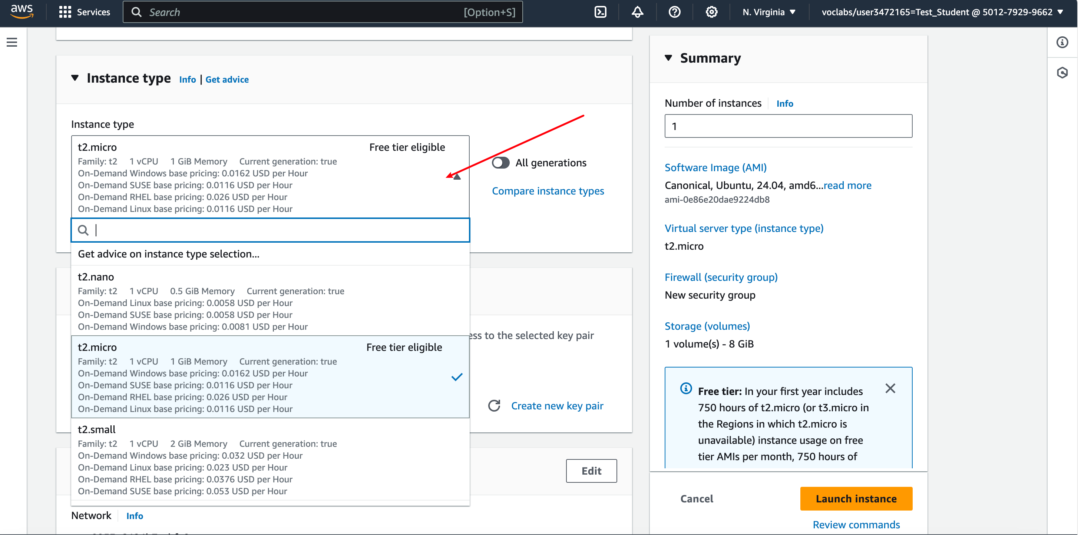
Launch an EC2 instance
For example, choose t3.micro
where t3: one class of General Purpose instances
micro: one tier of hardware specifications

Slide 35
EC2 instance types
General Purpose: a balance of compute, memory, and network resources
Memory optimized: lowest cost per GB of RAM
Storage optimized: better disk I/O and higher storage capacity
Compute optimized: lowest cost per vCPU
...
* For detailed information: https://aws.amazon.com/ec2/instance-types/

Slide 36
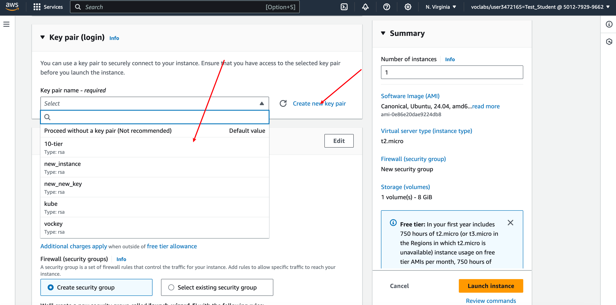
Launch an EC2 instance
Create new key pair or
use an existing pair

Slide 37
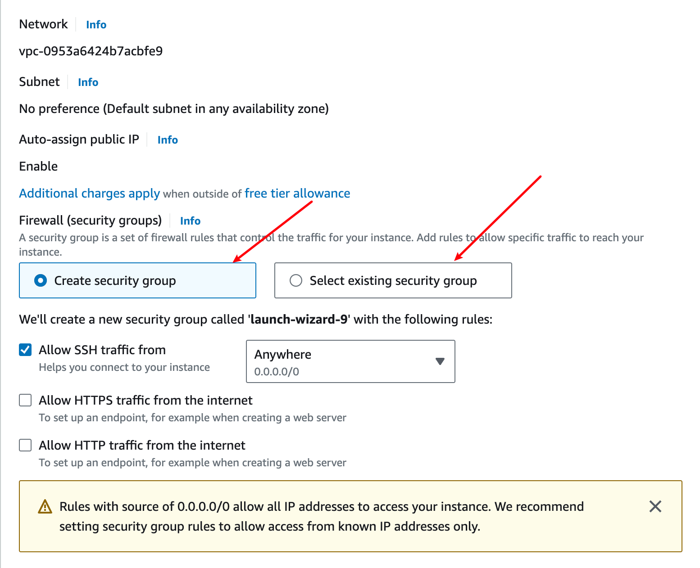
Launch an EC2 instance
Create new security group or
use an existing group

Slide 38
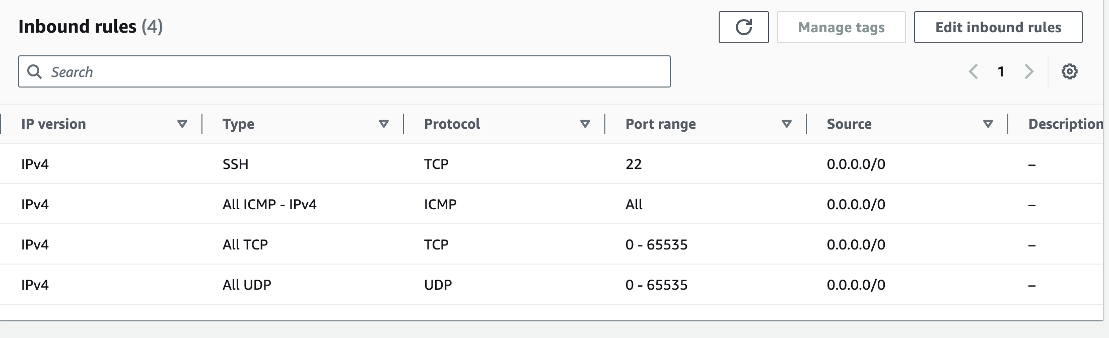
Launch an EC2 instance
Add/Edit/Delete security rules if necessary
Caution! The default security group only enables port 22 for SSH programs from any source IPv4 address (0.0.0.0/0) to access your instance. You may want to allow programs from other IP address and ports to access to your instance.
Notes:
What are security groups used for?

Slide 39
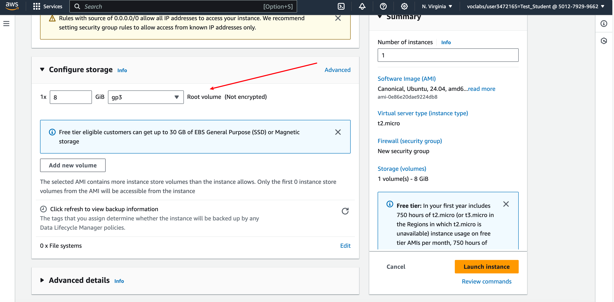
Launch an EC2 instance
Configure your instance if necessary, then Launch

Slide 40
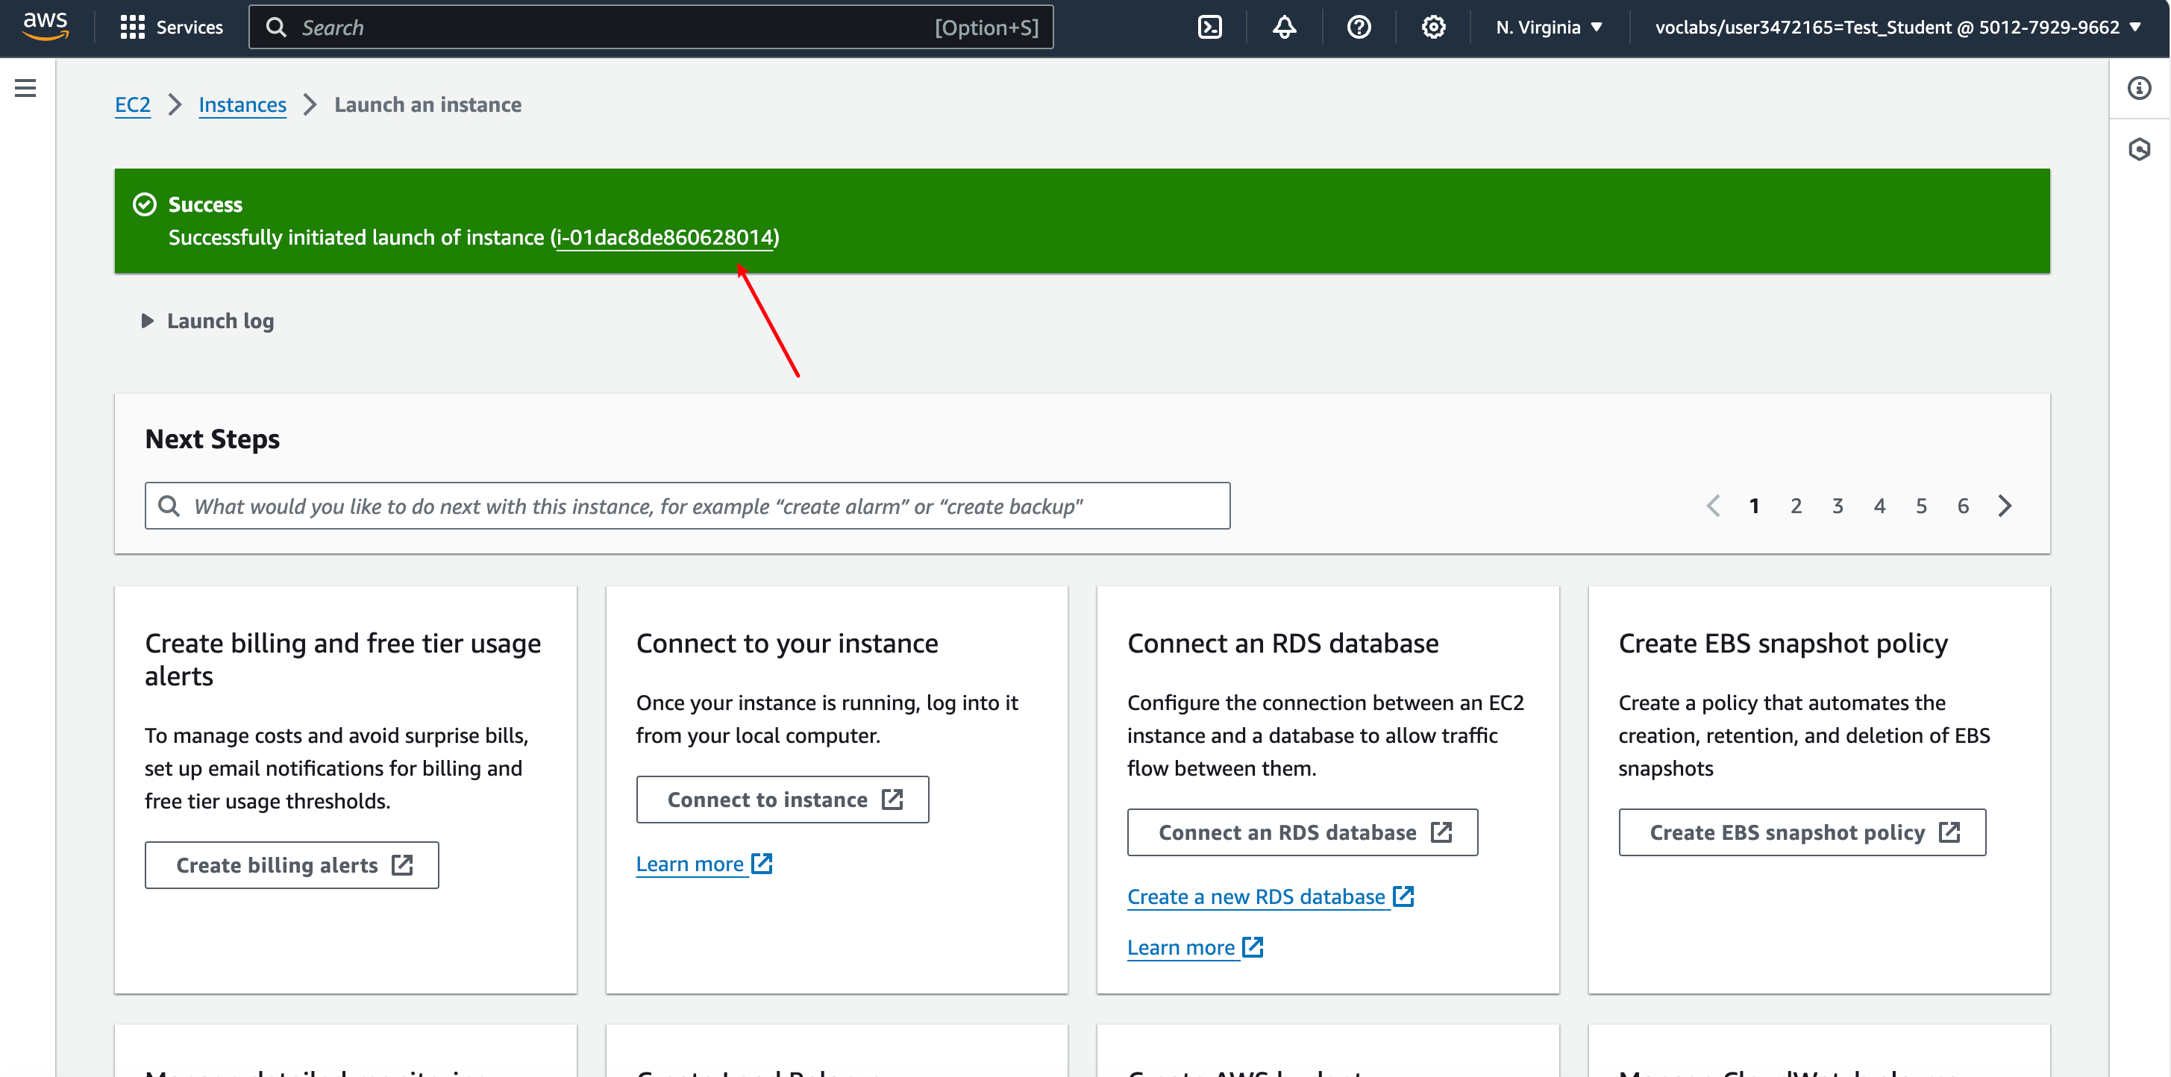
Launch an EC2 instance
Successfully launch the EC2 instance

Slide 41
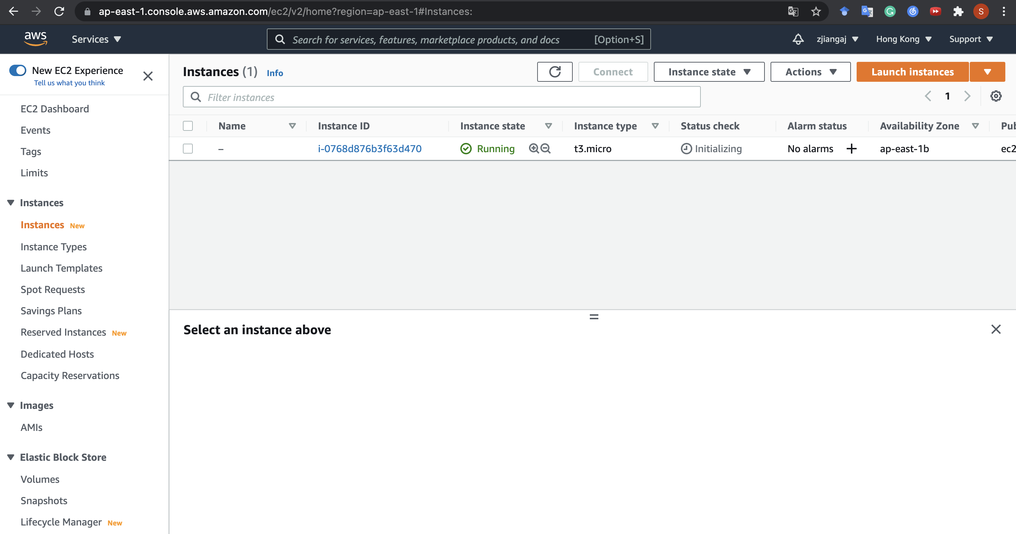
Launch an EC2 instance
Well done! You can now see it running!

Slide 42
Outline
Create an AWS Account
Launch an EC2 Instance
Connect to an Instance
Stop an EC2 Instance

Slide 43
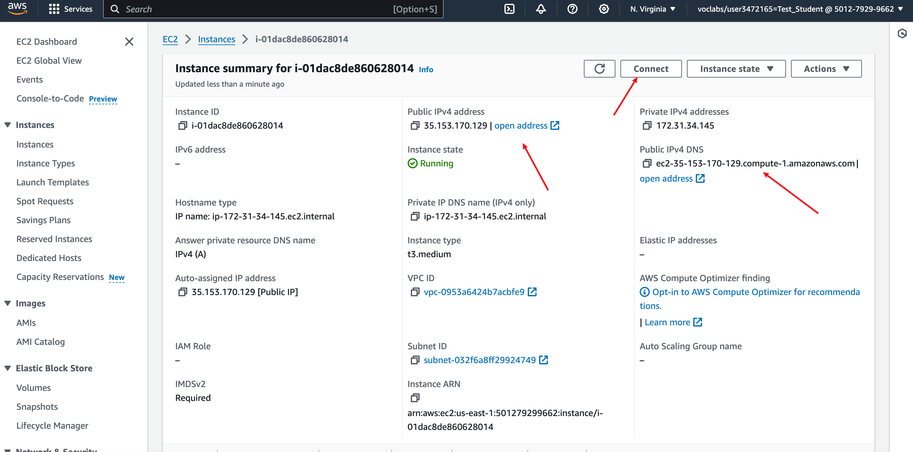
Launch an EC2 instance
ssh –i <path_to_private_key> <user_name>@<server>

Slide 44
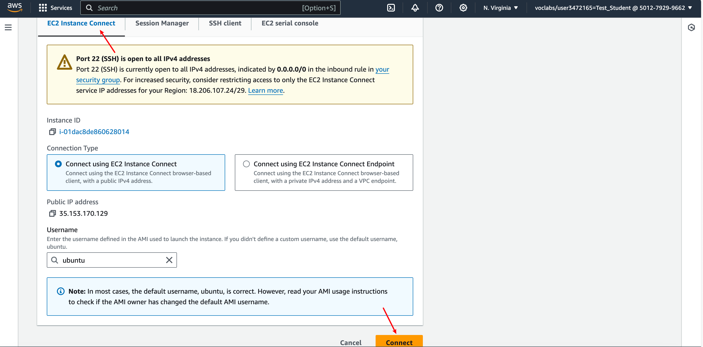
Connect to an EC2 instance
Connect via the browser

Slide 45
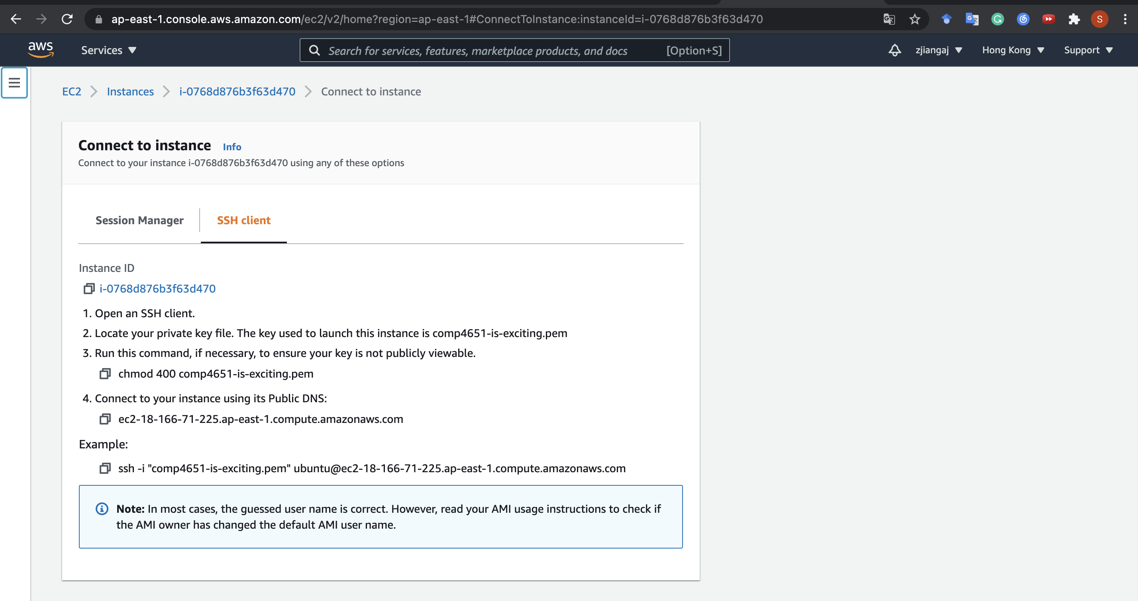
Connect to an EC2 instance
Connect via the terminal
Just follow~

Slide 46



Public vs. Private IP
reachable within the same network
e.g., connecting from another instance in the same availability zone
(Never change)
reachable from the Internet
e.g., used in SSH from your laptop
(Change each time you start the instance!)

Slide 47
Connection Test
To test whether your instance is connected to the Internet, access google from your EC2 instance. Type the command in the SSH shell after successfully connecting to the instance. The command will download the homepage of Google to your current directory.
To test the connection from your computer to EC2 instance, upload a file from local computer to EC2 instance. Type the command in another terminal without SSH connection. The command copies <local_file> to the directory “~” of the remote instance.
scp -i <private_key_path> <local_file_path> ubuntu@<public_ip>:~

Slide 48
Outline
Create an AWS Account
Launch an EC2 Instance
Connect to an Instance
Stop an EC2 Instance

Slide 49
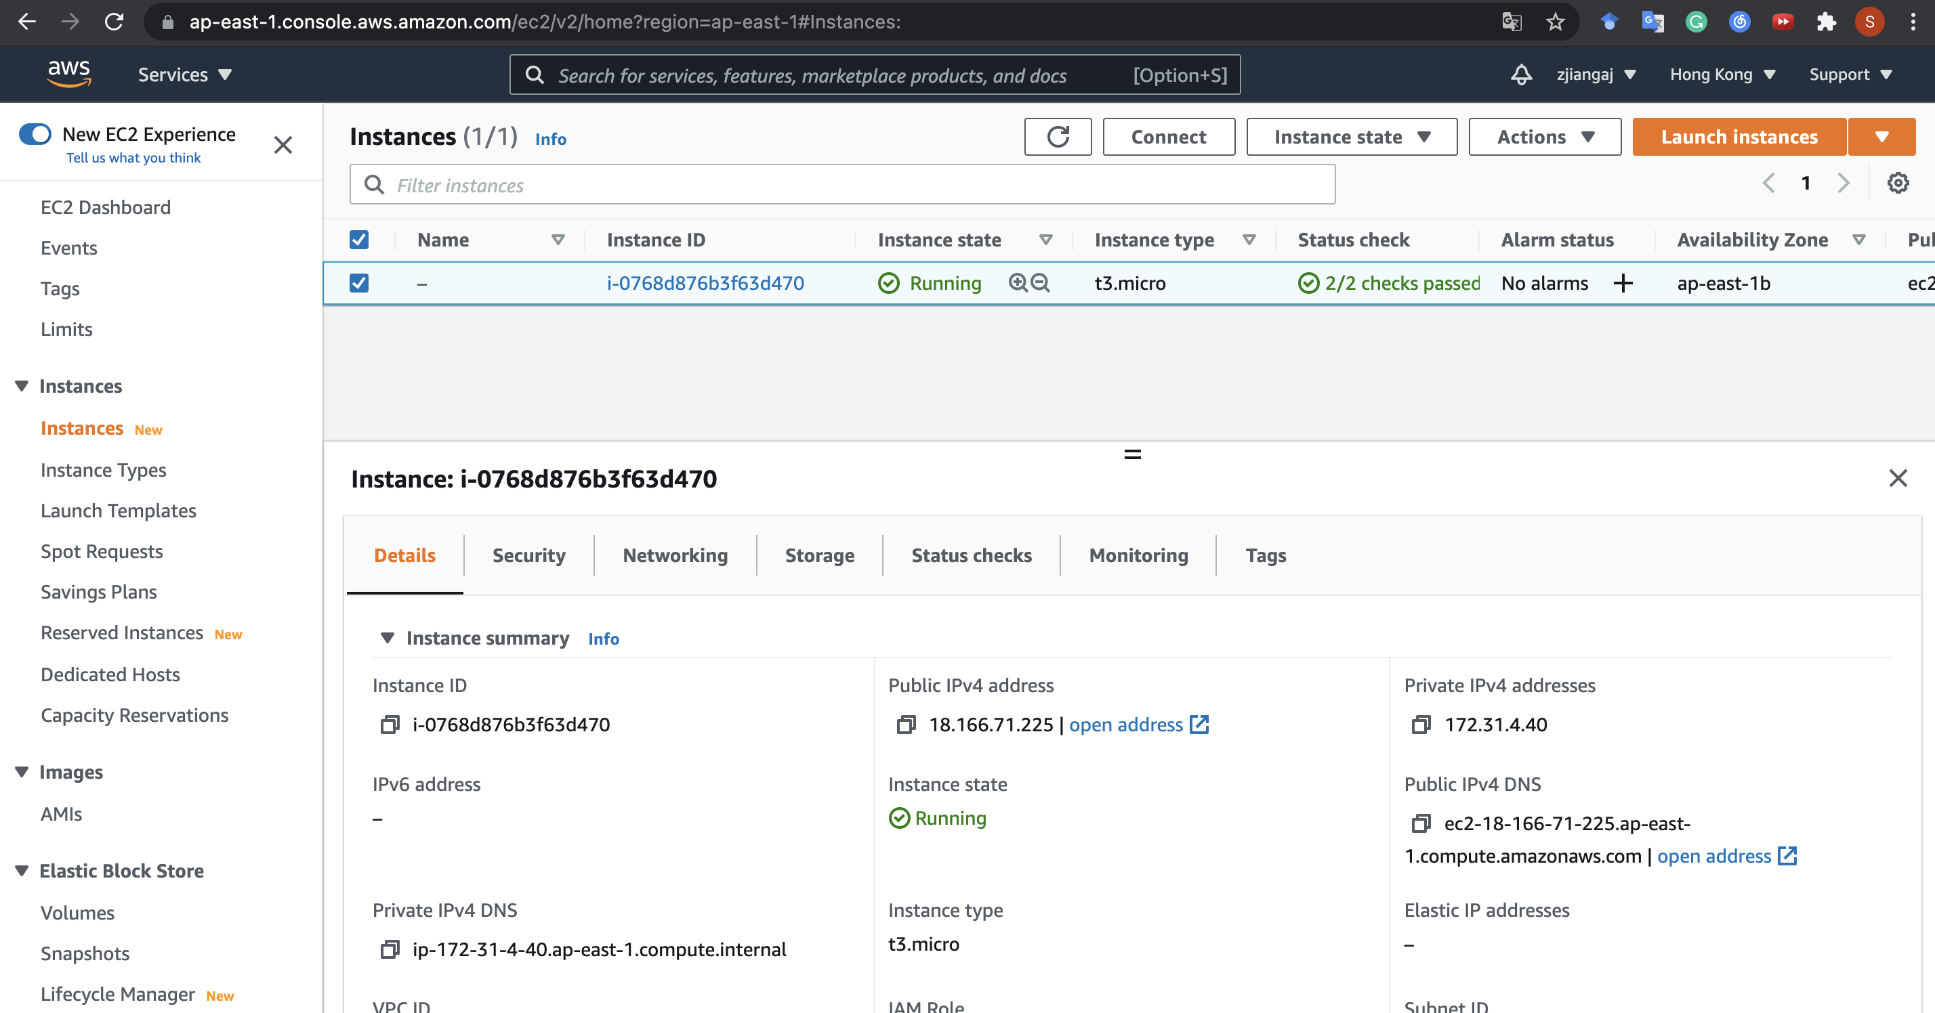
Stop an EC2 instance
Find the running instance

Slide 50
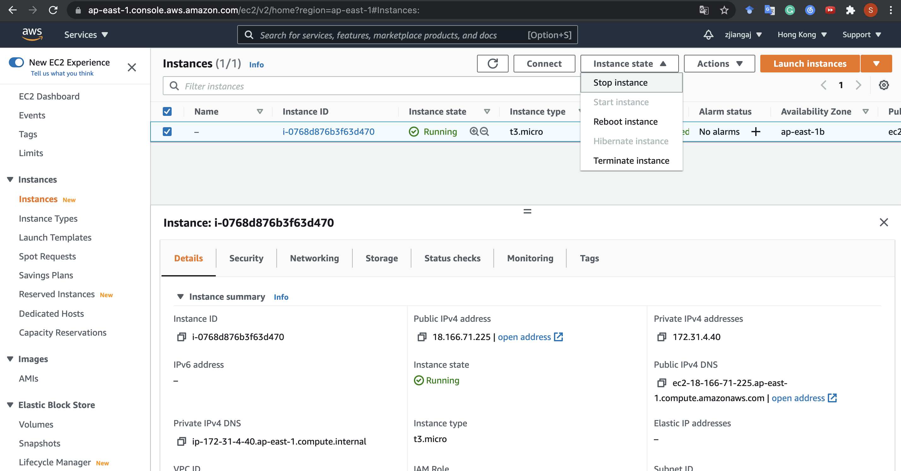
Stop an EC2 instance
Select Stop
(Not Terminate!)
Stop: I won’t use it now, but I want to start it later (so your programs and data remain)
Terminate: I will never use it again, and thus I would like to forget about it forever

Slide 51
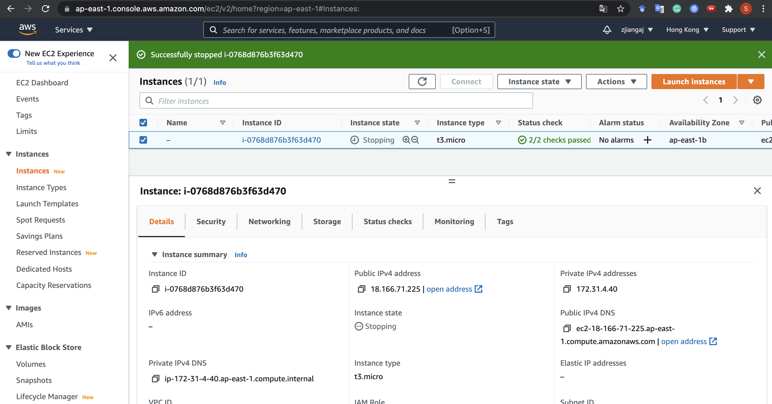
Stop an EC2 instance
On success you will see this

Slide 52
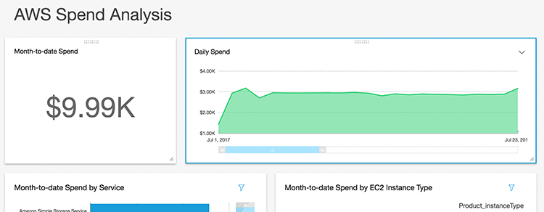
Stop an EC2 instance
Remember to stop the instance!!!
Otherwise, do expect bill like this:

Slide 53
CSC4160 (Fall 2024)
Getting Started with AWS EC2
Questions are welcome

